Slide 1
Chapter One: Review
How Effectively does Canada’s Federal Political System Govern for all Canadians?

Slide 2
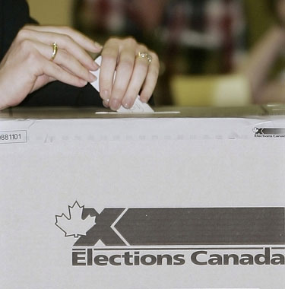
Electoral Process of Canada
Canada is a democratic country: a system of government by all eligible members
Canada is a representative government: individuals are chosen by election to represent groups of people
Canada is a responsible government: the elected government is responsible to the people

Slide 3
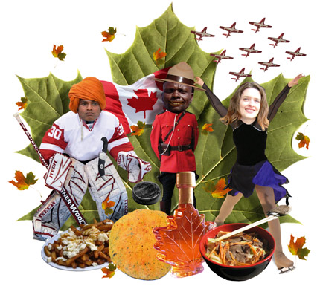
Electoral Process of Canada
It is impossible to govern to all Canadians. The government is likely to make decisions that represent the majority opinion. They govern to the majority so they get re-elected

Slide 4
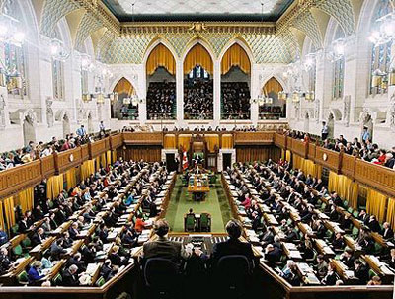
House of Commons
Made up of 308 elected members of parliament
Responsible for making laws in Canada as well as the day to day business of government
Represent constituents

Slide 5
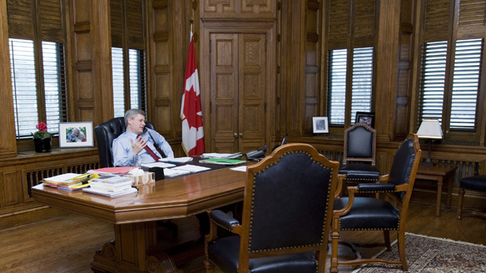
Head of Government
Canada’s head of government is the Prime Minister (PM)
PM is the elected leader of her/his party and is an elected member of parliament (MP)
In a general election, the party with the most votes is asked to form a government, and the leader of the party becomes PM

Slide 6
What is a Political Party
A political party is a group of people who have similar ideas about how government should respond to issues facing society.
Parties develop policies based on the shared values of its members to respond to issues
Parties put forward candidates in elections in the hope of forming the government

Slide 7
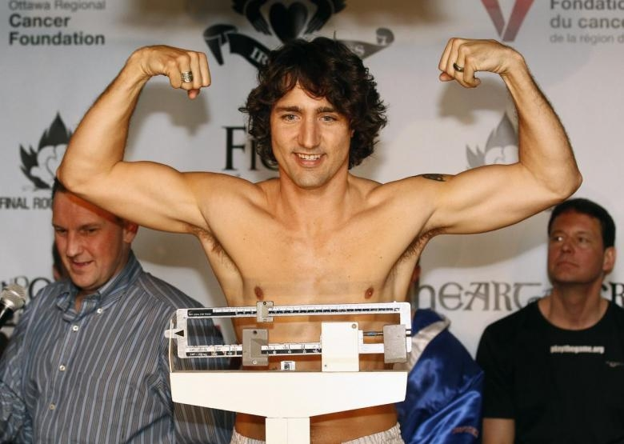
Prime Minister
The Prime Minister is the most powerful person in the government
He/she chooses the Ministers for the Cabinet and can also ask any one of them to resign.
Cabinet decisions do not necessarily go by majority vote.
A strong Prime Minister makes the final decision on all policy, even if most of the Cabinet are opposed.

Slide 8
Parliament
Parliament consists of the Queen represented by the Governor General, the Senate, and the House of Commons. The upper house is called the Senate and the lower house is called the House of Commons.
Members of Parliament or of a Provincial Legislature are normally elected for no more than five years.

Slide 9
The Senate
The Senate or Upper House is made up of 104 men and women. The members are appointed by the Governor General on the recommendation of the Prime Minister. Usually an appointment to the Senate is given as a reward for service to the country.
Senators must be at least 30 to be appointed and must retire at 75. They must reside in the province or territory for which they are appointed and own real estate worth $4000.

Slide 10
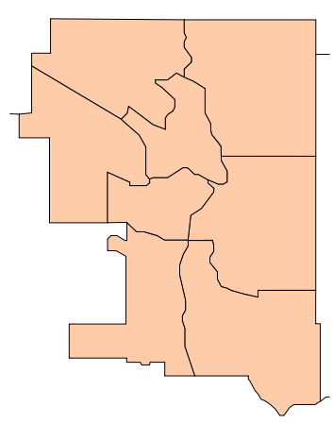
Elections
When an election is called, each party organises to have as many representatives run as possible
Each party seeks a dominant presence in each riding

Slide 11
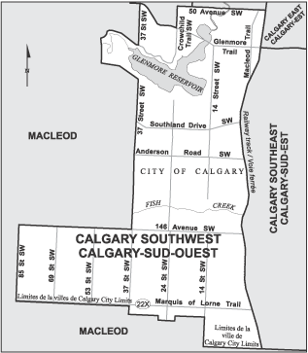
Elections
On the day of an election, registered members of a riding vote for the candidates represented
The first candidate to win a simple majority (51%) of the votes in a riding is elected as MP
Known as “first past the post”

Slide 12
Elections
The party with the most elected members is asked to form the government
If a party wins the majority of seats in the House of Commons, it always forms the government
If a party wins the most seats in the House, but not a majority, it still forms the government as a minority, but it needs to negotiate with at least one other party to get majority support for its proposals

Slide 13
A Prime Minister of a majority government can call election no later than five years after the return of the writs of the last election
When a party is elected, it “forms” a government. When an election is called, a government is said to be “dissolved”

Slide 14
If a party holds a minority, the government can be dissolved by a call of non-confidence
A non-confidence motion is a motion put before the House of Commons that, if passed, means the government has lost the confidence of the House.
The Government must then either resign or ask to call an election

Slide 15
HOW DO LAWS BECOME LAWS?
A bill’s journey through our government

Slide 16
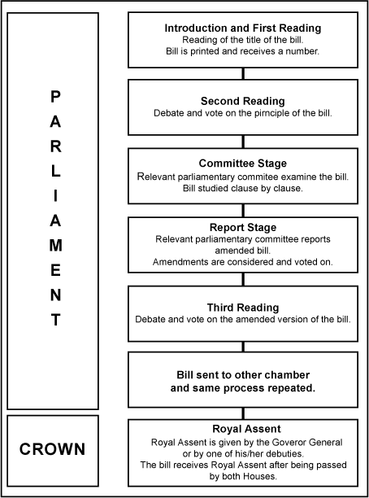

Slide 17
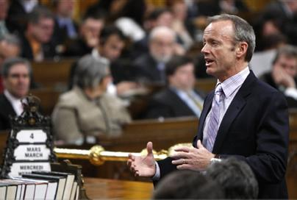
Introduction of A Bill
Bill is introduced by MP
If MP is a member of the government, it is known as a “Government Bill”
If MP is not a member of the government, it is known as a “Private Member’s Bill”
Private Member’s Bills are drawn randomly

Slide 18
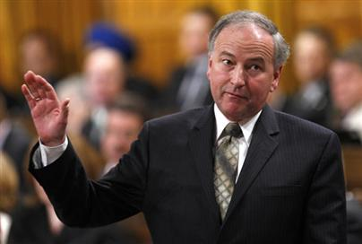
Second Reading
Focuses on the principle of the bill- what it will do and why it is needed
Heavily debated
Opposition parties against a bill will use stall tactics
Amendments are allowed: Reasoned, Discharged, Hoist

Slide 19

Committee Stage
Close examination of the bill
Add amendments, call on witnesses and experts to improve the bill
Studied word for word

Slide 20
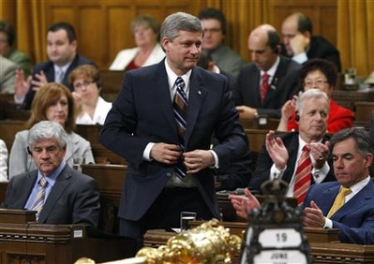
Report Stage
Agree on amended bill
Further amendments allowed as long as they don’t change the principle

Slide 21
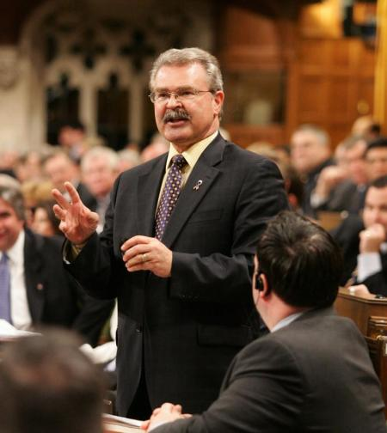
Third Reading
Debate about the bill in its entirety
Does it do what it is intended to do?
If agreed to, the bill is sent to the other chamber

Slide 22
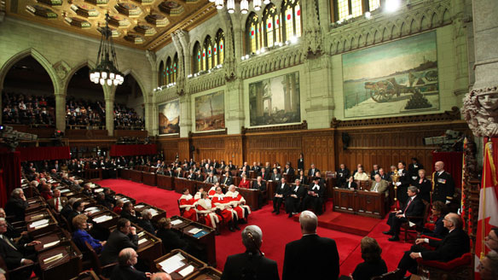
If once wasn’t enough…
Once it goes through the first house, it goes to the other to begin the process. Again.
Communicate by message as amendments are made

Slide 23
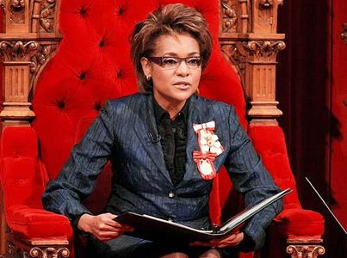
Finally: Royal Assent and Proclamation
Ceremony in Senate
Declaration at Rideau Hall
Announcement of bill’s acceptance in Her Majesty’s name
Deputy GG

Slide 24
Chapter Two: Review
To What extent is the Justice System Fair and Equitable for Youth?

Slide 25
Canada’s Justice System
How are youth justice and adult justice different in Canada?

Slide 26
Canada has different legislation for young people who break the law and for adults who break the law.
The Youth Criminal Justice Act (YCJA) was passed by parliament in 2003. Canada has had laws like the YCJA – that treat young offenders differently from adult offenders – since the 1890s.

Slide 27
Criminal Code of Canada
ADULT OFFENDERS
This law defines the consequences adults face for criminal offences.
Deals with adults in trouble with the law.
Going to court is the usual consequence for breaking the law.

Slide 28
Defines adult sentences, which can include long periods of imprisonment for some crimes.
Allows the publication of offenders’ names.
Creates a criminal record for most offenders.

Slide 29
Youth Criminal Justice Act
Young Offenders
This law defines the consequences young people face for criminal offences.
Deals with 12 – 17 year olds in trouble with the law.
Allows some young offenders to face consequences such as counselling and community service.

Slide 30
Prohibits adult sentences for youths 12 to 14 years of age. Allows adult sentences for young people 14 years of age and older who have committed serious crimes.
Protects the privacy of young offenders. News media may not publish their names unless they receive an adult sentence.
Allows most young offenders to avoid a criminal record.

Slide 31
Chapter Three: Review
How Effectively Does Canada’s Charter of Rights and Freedoms Protect Your Individual Rights?

Slide 32
Rights and Freedoms
A right is a legal, moral or social entitlement that citizens can expect, mainly from the government (right to a fair trial).
Freedom, although limited, means the right to conduct one’s affairs without government interference (limited by the need for public safety and the protection of other people’s rights).

Slide 33
Inalienable Rights are guaranteed entitlements that cannot be transferred from one person to another and cannot be taken away without due process of law (equality, liberty).
Franchise; the right to vote (women, minorities) is an important inalienable right

Slide 34
In Canada, all citizens have a legal duty to respect the legal rights of others
If citizens feel their legal rights are being violated, they can turn to the law to ensure their rights are respected.

Slide 35
Fundamental Freedoms
Freedom of conscience and religion
Freedom of thought and expression
Freedom of peaceful assembly and association

Slide 36
Other Important Rights
Democratic Rights
Mobility Rights
Legal rights which address…..
- Life, liberty and security of the person
Unreasonable search and seizure
Arbitrary detention or imprisonment
Cruel and unusual punishment

Slide 37
Chapter Four: Review
To What Extent has Canada Affirmed Collective Rights?

Slide 38
Aboriginal Rights in Canada
Understand yourself as an individual (shaped by culture, community, values, past)
Perspective is sharing your point of view with others, finding commonalities (the groups you associate and move through)

Slide 39
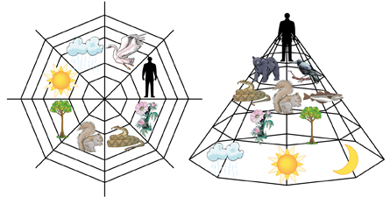
Aboriginal Rights in Canada

Slide 40
Aboriginal Rights in Canada
Royal Proclamation of 1763
  Recognized First Nations land claims
  Set aside land for Aboriginal use
BNA Act 1867
  Gave jurisdiction of First Nations to Canadian government

Slide 41
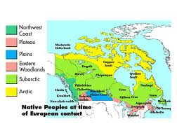
Aboriginal Rights in Canada

Slide 42
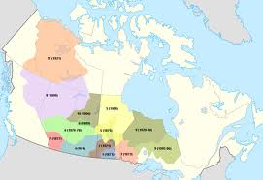
Aboriginal Rights in Canada
Numbered Treaties
  First Nations negotiated with Crown “Nation to Nation”
In order to make the “National Dream” a reality, the Canadian government needed control of lands controlled by First Nations

Slide 43
Aboriginal Rights in Canada
Numbered Treaties
Canadian government negotiated for those lands in exchange for smaller reserves, annuity payments
Aboriginal way of life threatened by disease, near-extinction of bison

Slide 44
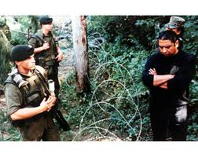
Aboriginal Rights in Canada
Indian Act of 1876
Defined who is Indian, who has rights
Government sought to “assimilate” First Nations by educating children in European culture and life

Slide 45
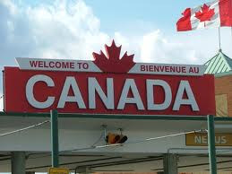
Official Language Groups

Slide 46
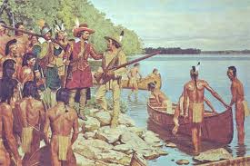
Official Language Groups
French and English were earliest settlers of North America
French primarily found in what is now known as Atlantic Canada.

Slide 47
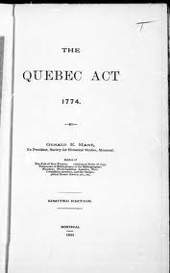
Official Language Groups
1774
  Recognized and guaranteed French Rights and identity
BNA Act 1867: legislation protected bilingualism and biculturalism

Slide 48
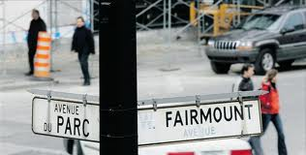
Official Language Groups
Official Languages Act of 1969 officially protects and recognizes Canada’s two used languages
Charter of Rights and Freedoms 1982: Further enshrines language and cultural rights of Francophones and Anglophones

Slide 49

Official Language Groups
Official Language Minorities: Exist all over Canada within the larger population
Sometimes mix, sometimes remain distinct
In some cases, the languages spoken are not officially recognized

Slide 50


Métis and Canada

Slide 51

Métis and Canada
“We must cherish our inheritance. We must preserve our nationality for the youth of our future. The story should be written down to pass on.”
- Louis Riel, 1885

Slide 52
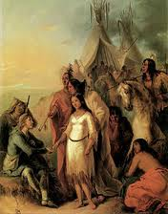
Métis and Canada
Considered a distinct aboriginal people
Dates back to early relationships between European fur traders and the First nations
Legacy of establishing and supporting trade relationships and communities in the western prairies

Slide 53
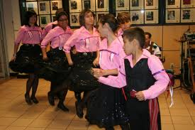
Métis and Canada
Alberta is home to 65 000 Métis today
Canada is home to 400 000 Métis
They are protected by Canada’s constitution as an Aboriginal people

Slide 54
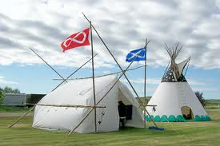
Métis and Canada
Long struggle to gain collective rights
Struggle to maintain collective identity
No historic treaties or land claims

Slide 55
Chapter Five: Review
How Well Do Canada’s Immigration Laws and Policies Respond to Immigration Issues?

Slide 56
Reasons Immigrants Come to Canada
Hope of a better life (opportunities)
Civil Unrest
War/Poverty
Limited opportunities in their native land (education/employment)

Slide 57
PUSH—PULL Factors
What makes people leave their home? (emigration)
What draws people to a new place? (immigration)

Slide 58
Push Factors
Reasons why people emigrate from a certain region or country; these may include political, economic, health, or security factors

Slide 59
Pull Factors
Reasons why people immigrate to a certain region or country; these may include political, economic, health, or security factors

Slide 60
Categories of Immigrants
Family
Economic Immigrants (post-secondary education/professionals)
Humanitarian/ Compassion
Refugees
Illegal Immigrants

Slide 61
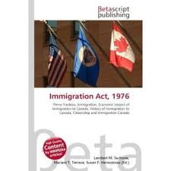
Immigration Act of 1976
Decided who would be allowed in, not who would be kept out
Provinces had power to set immigration laws
Those who could be a burden on social welfare or health services could be refused
Four new classes: Refugees, assisted relatives, families, independent immigrants

Slide 62
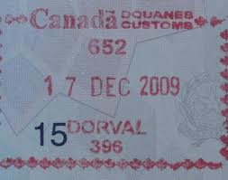
Immigration and Refugee Protection Act of 2002
Created a complex framework of goals and guidelines on who could and should be allowed into Canada

Slide 63
Immigration and Refugee Protection Act
Immigration policy should:
  Pursue social, economic, cultural benefits for all Canadians
  Respect bilingualism and multiculturalism
  Support minority language communities
  Support a prosperous economy across all regions of Canada
  Reunite Families
  Integrate immigrants into Canadian society, recognizing the obligations of both new immigrants and Canadian society

Slide 64
Chapter Six: Review
To What Extent do Different Economic Systems Affect Quality of Life?

Slide 65
AN INTRODUCTION TO ECONOMIC SYSTEMS
KEY QUESTIONS TO CONSIDER:
WHAT DO WE MEAN BY AN “ECONOMIC SYSTEM”?
-A way that a society organizes its economy- how a society organizes production, distribution, and consumption of goods and services

Slide 66
AN INTRODUCTION TO ECONOMIC SYSTEMS
KEY QUESTIONS TO CONSIDER:
WHY DO WE NEED ECONOMIC SYSTEMS?
- Regulates production, distribution, and consumption of goods and services. People have jobs, spend money, and want a good quality of life. This is all affected by the economy.

Slide 67
AN INTRODUCTION TO ECONOMIC SYSTEMS
KEY QUESTIONS TO CONSIDER:
WHAT TYPES OF ECONOMIC SYSTEMS ARE THERE?
Market economy
Mixed economy
Controlled or Command economy

Slide 68
WHY WE NEED ECONOMIC SYSTEMS
ALL SOCIETIES FACE THE SAME ECONOMIC PROBLEM:
SCARCITY
UNLIMITED HUMAN WANTS
LIMITED RESOURCES
THERE ARE NEVER ENOUGH RESOURCES IN A SOCIETY TO SATISFY ALL THE PEOPLE’S WANTS, THEREFORE A SCARCITY OF RESOURCES ALWAYS EXISTS

Slide 69
WHAT IS AN ECONOMIC SYSTEM?
CAN BE DESCRIBED AS:
Any system or method a society uses to meet the needs and wants of its citizens. It is how a society organizes the production, distribution and consumption of goods and services

Slide 70
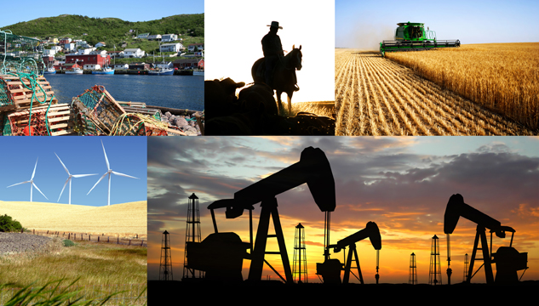
Economic Organization-Primary Industry

Slide 71
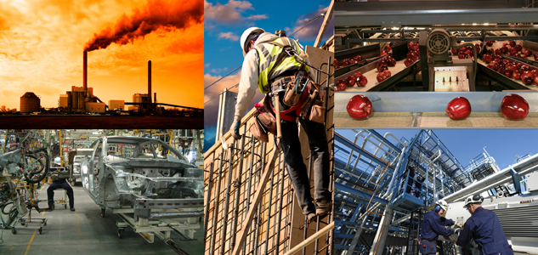
Economic Organization-Secondary Industry

Slide 72

Economic Organization-Tertiary Industry

Slide 73

Economic Organization-Quaternary Industry

Slide 74
HOW SOCIETIES DEAL WITH SCARCITY
SOCIETIES (AND THE PEOPLE IN THEM) MUST MAKE CHOICES ABOUT THE LIMITED RESOURCES AVAILABLE TO THEM AND DECIDE HOW TO ALLOCATE THE RESOURCES TO MEET PEOPLE’S WANTS
THE ALLOCATION OF SCARCE RESOURCES (SCARCITY) IS THE BASIC ECONOMIC PROBLEM FACED BY ALL SOCIETIES

Slide 75
THE FOUR BASIC ECONOMIC QUESTIONS ALL SOCIETIES MUST ANSWER
1. WHAT GOODS AND SERVICES TO PRODUCE
2. HOW MUCH SHOULD BE PRODUCED?
3. HOW ARE GOODS AND SERVICES TO BE PRODUCED?
4. FOR WHOM ARE GOODS AND SERVICES PRODUCED?

Slide 76
ECONOMIC SYSTEM SUMMARY
Unlimited
WANTS
1.WHAT goods and services to produce
2. HOW MUCH is to be produced
3. HOW goods and services will be produced
4. FOR WHOM goods and services will be produced
THEREFORE, SOCIETIES MUST MAKE CHOICES:
SCARCITY
Limited
RESOURCES

Slide 77
MEANS (FACTORS) OF PRODUCTION
ANY TIME A GOOD OR SERVICE IS PRODUCED, THREE TYPES OF RESOURCES GO INTO MAKING IT:
LABOR
CAPITAL
LAND
ALSO CALLED “NATURAL RESOURCES”
SOIL, WATER, MINERALS ETC.
ALSO CALLED “HUMAN RESOURCES” EFFORTS PEOPLE MAKE TO PRODUCE GOODS
ALL MONEY USED TO PURCHASE, MAINTAIN MACHINES, FACTORIES, COMMUNICATIONS ETC, AND EQUIPMENT

Slide 78
TWO IMPORTANT TYPES OF ECONOMIC SYSTEMS
MARKET ECONOMIES (Capitalism, Free Enterprise, Laissez faire)
2. COMMAND ECONOMIES (Centrally Planned Economy, Communism)
VALUE POSITIONS:
RESOURCES SHOULD BELONG TO INDIVIDUALS
FREEDOM IS MOST IMPORTANT
“LET THE MARKET DECIDE”
VALUE POSITIONS:
THERE SHOULD BE COMMON (STATE) OWNERSHIP OF RESOURCES
UNCONTROLLED CAPITALISM CREATES GREAT INEQUALITY
EQUALITY IS MOST IMPORTANT

Slide 79


Slide 80
Equilibrium
Supply
Producers
Demand
Consumers
Price

Slide 81
Demand Increases
Demand
Consumers
Supply
Producers
Price
When demand goes up, it means more and more consumers are buying the product
This drives up the price of the product, because more consumers compete for the limited supplies available
As consumers buy the product, the supply (or availability) of the product drops

Slide 82
Price Increases
Price
Demand
Consumers
Supply
Producers
When price of a product goes up, fewer consumers can afford to buy it
Fewer consumers buy the product, so the supply (availability) goes up
This drives down demand for the product

Slide 83
Market Readjusts and Returns to Starting Point
Supply
Producers
Price
Demand
Consumers
When the supply of a product goes up, more of the product is available
The lower price encourages consumers to buy more, so demand for the product goes up
If there are more products available than consumers want to buy, producers cut prices to encourage consumers to buy more

Slide 84
Chapter Seven: Review
What Role Should Consumerism Play in our Economy?

Slide 85
Consumerism is:
Economic policies placing emphasis on consumption. It is the belief that the free choice of consumers should dictate the economic structure of a society

Slide 86

IDENTITY
Consumers tend to buy products that match their identity: brands, labels, mascots that fit with their beliefs and values.

Slide 87

HEALTH AND SAFETY
Consumers tend to buy products that provide more safety or health benefits.

Slide 88

JOBS
Consumers will sometimes buy products that will support certain peoples’ jobs or livelihoods. i.e. “Buy Canadian”.

Slide 89
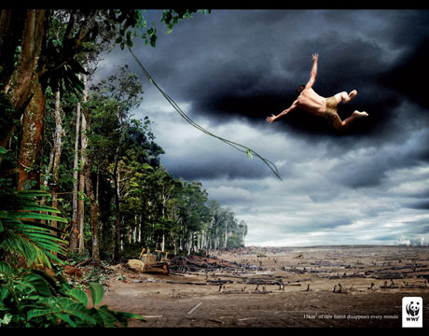
ENVIRONMENT
Consumers will often try to buy products that offer less impact on the environment.

Slide 90

MARKETING
Marketing and advertising campaigns are very important for drawing consumer attention to certain products and services.
Bandwagon Effect, Emotional Appeal, Glittering Generalities, Plain Folks Appeal, Testimonials, Scientific Appeal

Slide 91
Chapter Eight: Review
To What Extent Should Canadians Support Social Programs and Taxation?

Slide 92
Social programs are services provided by government and paid for by taxes.
HEALTH CARE
EDUCATION
PENSIONS
CHILD PROTECTION SERVICES
EMPLOYMENT INSURANCE
AFFORDABLE HOUSING
INCOME ASSISTANCE

Slide 93


How do the economic philosophies and values of Canada and the U.S. reflect their social programs?
“Peace, order and good government”
“Life, liberty and the pursuit of happiness”

Slide 94
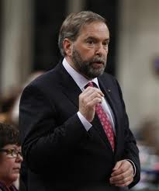
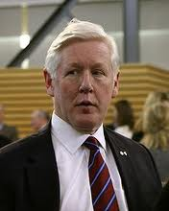
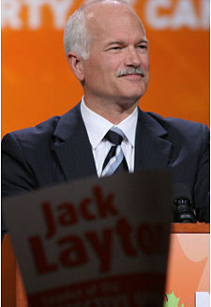


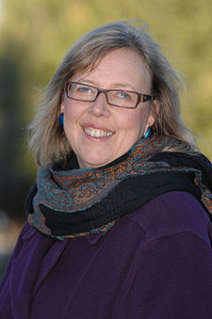
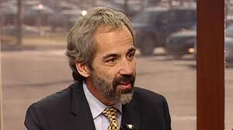
The Economic Continuum
Planned economy Mixed Economy Market Economy
More government involvement
Less government involvement

Slide 95
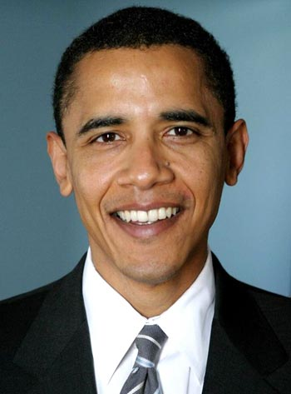
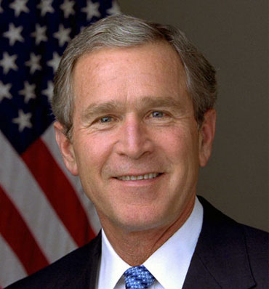
The Economic Continuum
Planned economy Mixed Economy Market Economy
More government involvement
Less government involvement

Slide 96
Chapter Nine: Review
How Should Governments Respond to Political and Economic Issues?

Slide 97
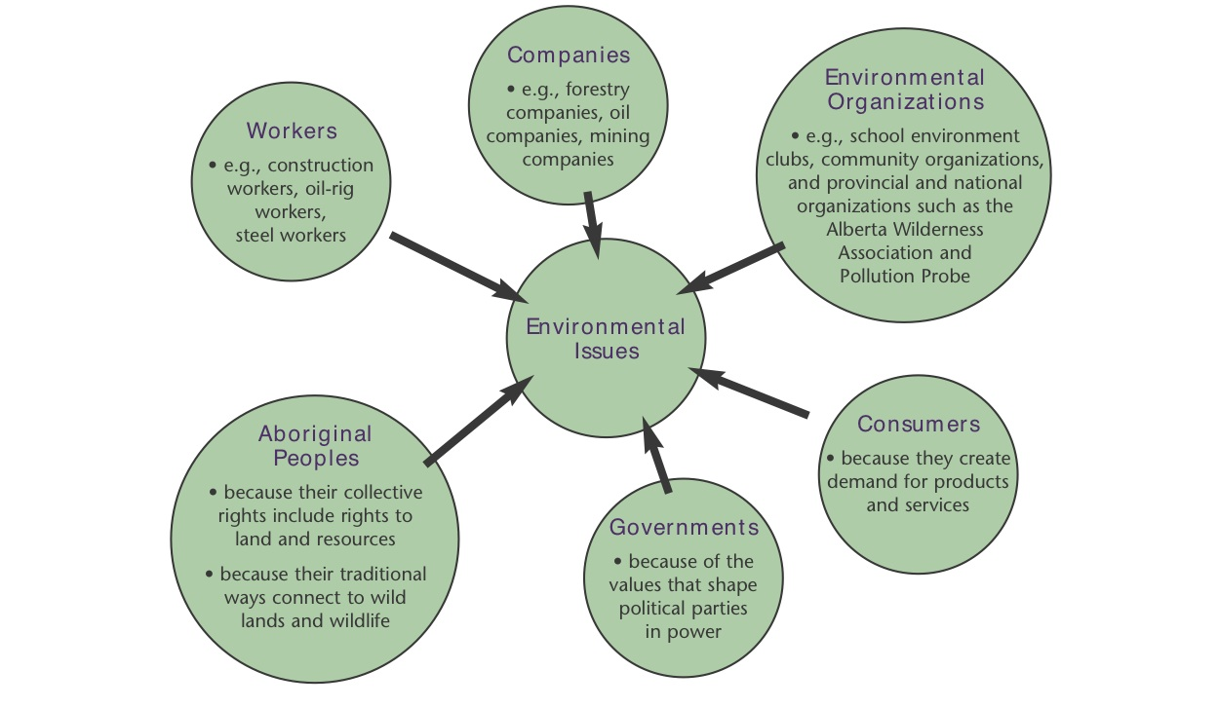
What is an Environmental Issue?
Notes:
- Multiple perspectives always need to be considered, it is never just black or white. Everyone has a stake in an issue as complex as the environment.

Slide 98
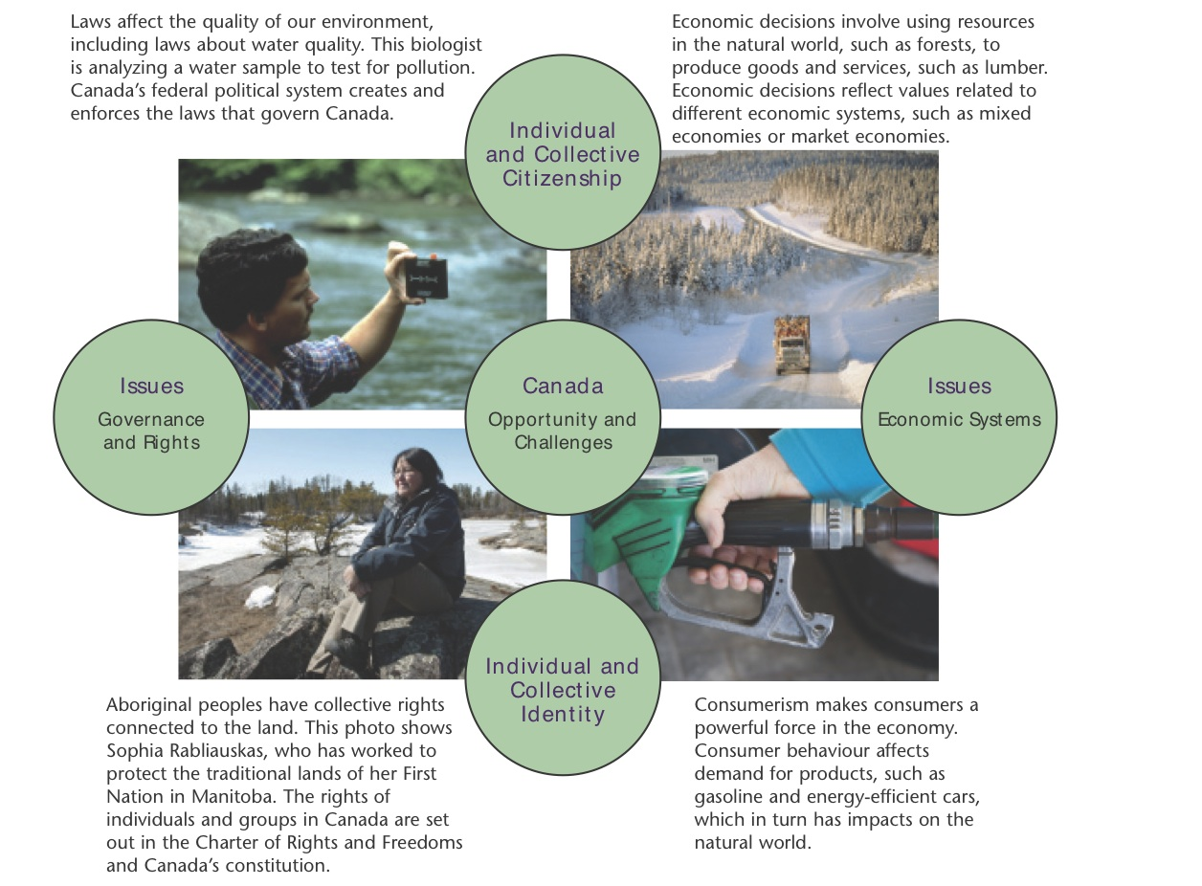
Mind Map of Environmental Issues
Notes:
- In the centre is Canada with opportunities/challenges as they relate to the environment. On one axis are ideas of government and economics, on the other the ideas of citizenship and identity, both individual and collective
- We all fit into the various bubbles as issues affect our lives

