Slide 1
Slide Deck 6: The Voting Process

Slide 2
Why do you think it is important to VOTE?

Slide 3
The Right to Vote
The right to vote in Canada has not always been universal
It has been withheld from many groups throughout Canada’s history based on gender, race, religion and occupation
Universal suffrage is the extension of the right to vote to all adult citizens, including the removal of property ownership requirements and restrictions against women, Indigenous peoples, ethnic and religious minorities

Slide 4
Can you name any groups who were initially denied the right to vote?

Slide 5
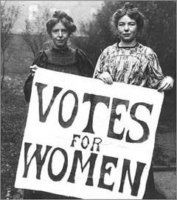
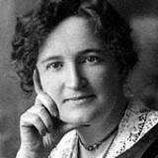
Women’s Suffrage
Initially, only men who owned property could vote in Canada
Women in Canada eventually gained the right to vote (suffrage) following years of persistent protest
Alberta women received the right to vote and run for office provincially in 1916
In 1917, voting rights were extended to women in Canada for federal elections with some restrictions
Canadian women gained the right to run for federal office in 1919

Slide 6
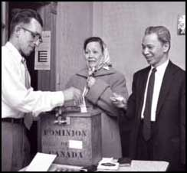
Universal Suffrage
Men and women of several ethnic and racial minorities, such as Canadians of Chinese and Japanese origin and Indigenous peoples, were still disenfranchised for several decades after women achieved the right to vote
The last of the limitations for various ethnic and religious groups were not removed until 1960
Universal suffrage is the extension of the right to vote to all adult citizens

Slide 7
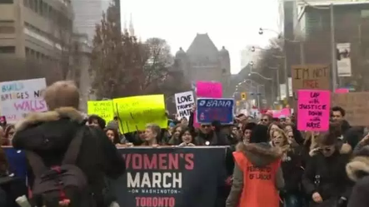
Are there any groups today who still feel it is necessary to protest for equal treatment?
Who are they? Do you think protesting is effective?

Slide 8
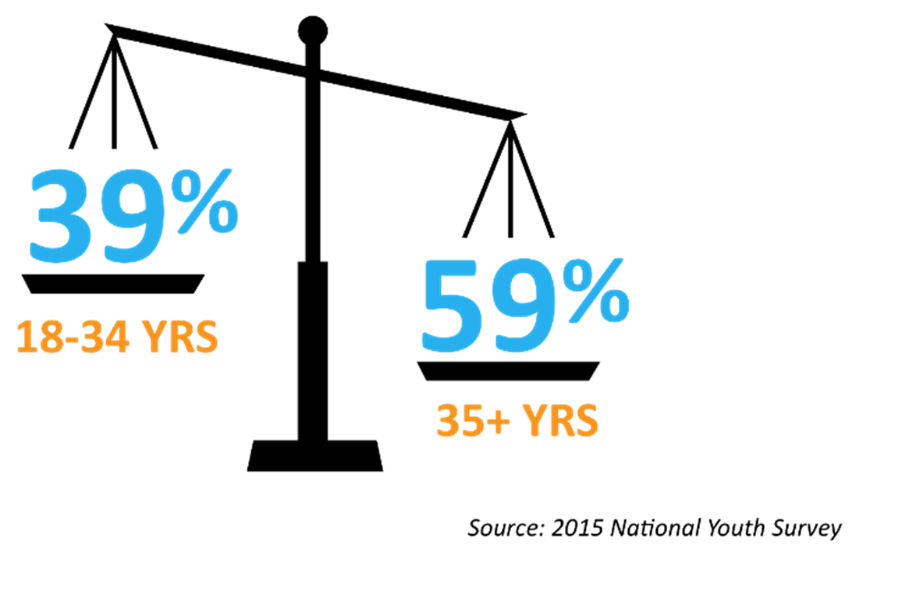
Electoral Participation
Despite moving beyond these injustices, electoral participation has been on the decline in Canada over the past several decades
In particular, low voter turnout is usually disproportionately concentrated among young Canadians

Slide 9
Why you do you think voter turnout is lower among young Canadians?

Slide 10
On October 16, 2017, citizens across the province will vote to elect candidates for their municipal councils and school authorities

Slide 11
How do you know if you are eligible to vote?

Slide 12
Voter eligibility
In order to be eligible to vote in the municipal elections, you must:
Be 18 years of age;
Be a Canadian citizen; and
Have resided in Alberta for six months immediately preceding election day and your place of residence must be located in the area on election day

Slide 13
Eligible voters
An elector is usually eligible to vote in the jurisdiction or ward/division in which they live or own property
Voters may vote only once in a single municipality; if a person has more than one property in Alberta, they must designate one place of residence for the purpose of voting
The exception being electors who own both property in a summer village and another municipality, in which case they are eligible to vote in both locations
Some municipalities compile a list of electors (also known as a voters list) with the names and addresses of all eligible electors, which is used at the voting station

Slide 14
What do you need in order to vote?

Slide 15
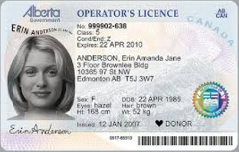
Voter identification
In order to vote, you must produce one piece of authorized identification that establishes your name and current residential address
For example, a drivers’ license or utility bill would be acceptable, while a passport would not
Your municipality will have a list of the most common types of identification required to vote and the other types of identification that will be accepted
Electors should check with the municipal office or on the municipal website to confirm the options available to them

Slide 16
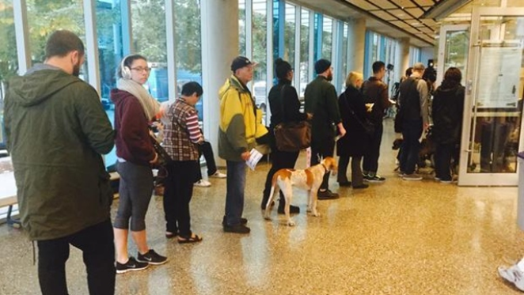
Voting Methods
Each municipality in Alberta runs their own elections and determines which voting methods are available to electors
Electronic voting (e-voting) is a term that can be applied to various technologies using electronic means to help in the process of casting or counting ballots, such as tabulators
The Student Vote election will use traditional paper ballots with manual counting

Slide 17
Can you explain how the voting process works for local elections?

Slide 18
How do I mark my ballot?
Voting is done by secret ballot. No one except the voter knows the choice that was made
A ballot lists the names of the candidates running for each position in your local elections
The voter must clearly mark the ballot for one candidate for it to be accepted (e.g., checkmark, X, shading in)

Slide 19
Why is it important that we vote by secret ballot?
What could the consequences be if elections were held publicly?

Slide 20
Local Elections
Depending on where you live, you may be able to vote for three positions:
Mayor or reeve
As long as this position is electable in your municipality
Councillor or alderman
One or several, depending on your council structure
School board trustee
Public, separate or Francophone regional school authority

Slide 21
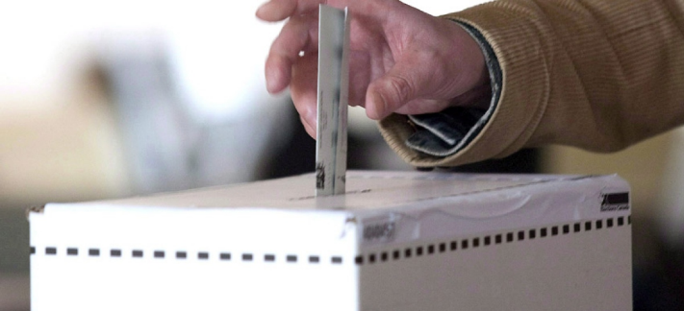
How does the voting process work?
The voting process at a voting station works as follows:
Once you confirm your eligibility, you are given a ballot;
You go behind a voting screen and mark your ballot;
Then re-fold your ballot and hand it back to the ballot clerk for verification; and
After it has been verified, your ballot is placed in the ballot box.

Slide 22
Rejected, Spoiled and Declined Ballots
A rejected vote is not counted because it was not properly marked. This can include selecting more than the allowed number of candidates, or if the voters’ intention is unclear. One race or section may be declared valid and another may be deemed rejected
A spoiled ballot is a ballot that is torn or marked mistakenly and exchanged for a new ballot. It is kept separate and not placed in the ballot box
If an elector returns a ballot and states that they are declining to vote, the elector is not entitled to another ballot, and the declined ballot is deposited in the ballot box. The declined ballot will eventually be counted as a rejected ballot

Slide 23
Why might someone choose to decline their ballot?

Slide 24
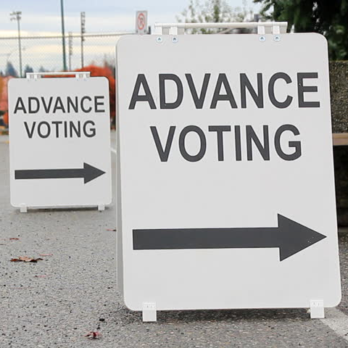
What is advance voting?
Electors who are away, busy or unable to vote on election day have the option of advance voting
Advance voting is held prior to election day
Dates and times are set by each municipality

Slide 25
Debrief
Are you ready to vote? What else can you do to prepare for Student Vote Day?
How can you encourage eligible voters to cast their own ballots?
Will you vote in the future when you turn eighteen?

