Slide 1
People in Space
Topic 8
Space Exploration

Slide 2
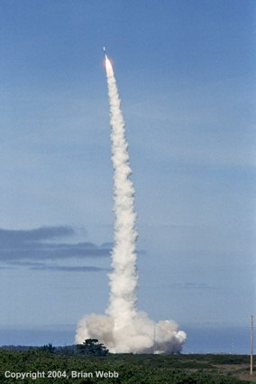
Breaking Free of Earth’s Gravity
The major problem with getting things into space is Gravity
In order to overcome gravity it takes a lot of energy
In order to get an object into space and free of Earth’s gravitational pull completely the object must travel at a speed of 8 m/s (29000 km/h!)

Slide 3
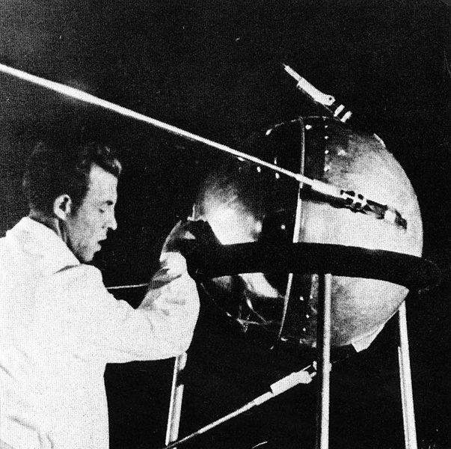
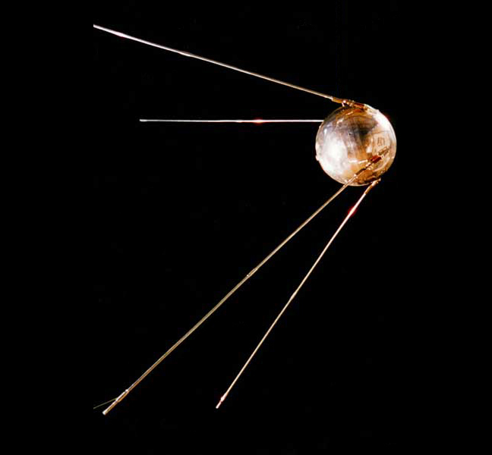
Breaking Free of Earth’s Gravity
Sputnik 1:
Sputnik 1 was launched by the Soviet Union in 1957
It was the first satellite in space ever

Slide 4
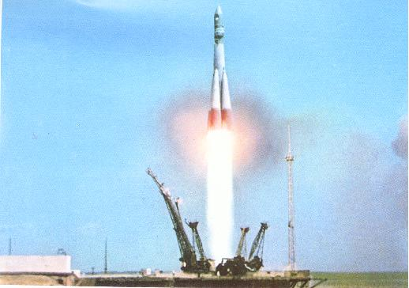
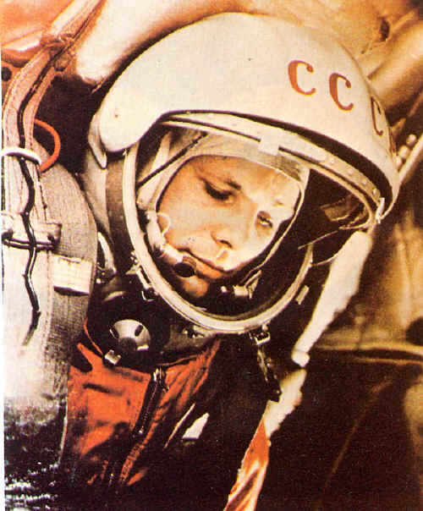
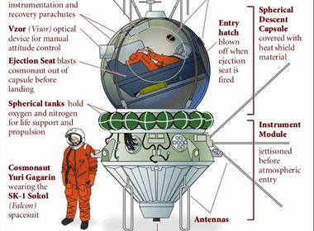
Breaking Free of Earth’s Gravity
Vostok 1:
Vostok 1 was the first rocket to take people into space
Vostok 1 was launched by the Soviet Union on April 12, 1961 and carried the cosmonaut Yuri Gagarin into space for the first time
He was the first person to see that the Earth was round

Slide 5
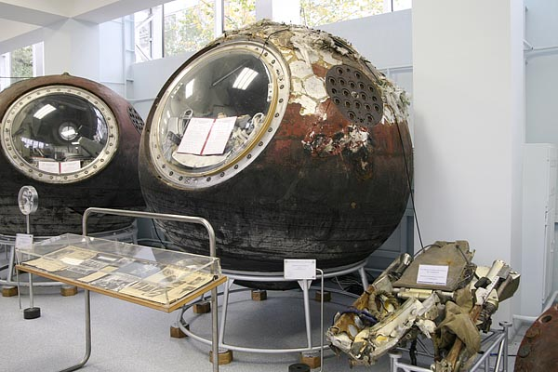
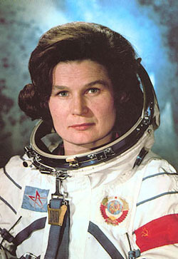
Breaking Free of Earth’s Gravity
Vostok 6:
Vostok 6 was the first rocket to take a female cosmonaut into space
Vostok 6 was launched by the Soviet Union on June 16, 1963 and carried the cosmonaut Valentina Tereshkova into space where she stayed for 3 days

Slide 6
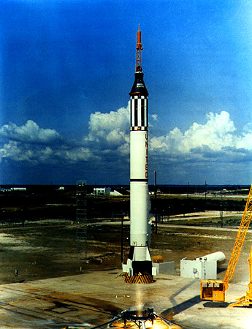
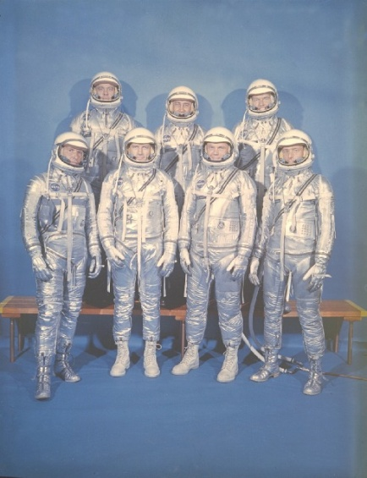
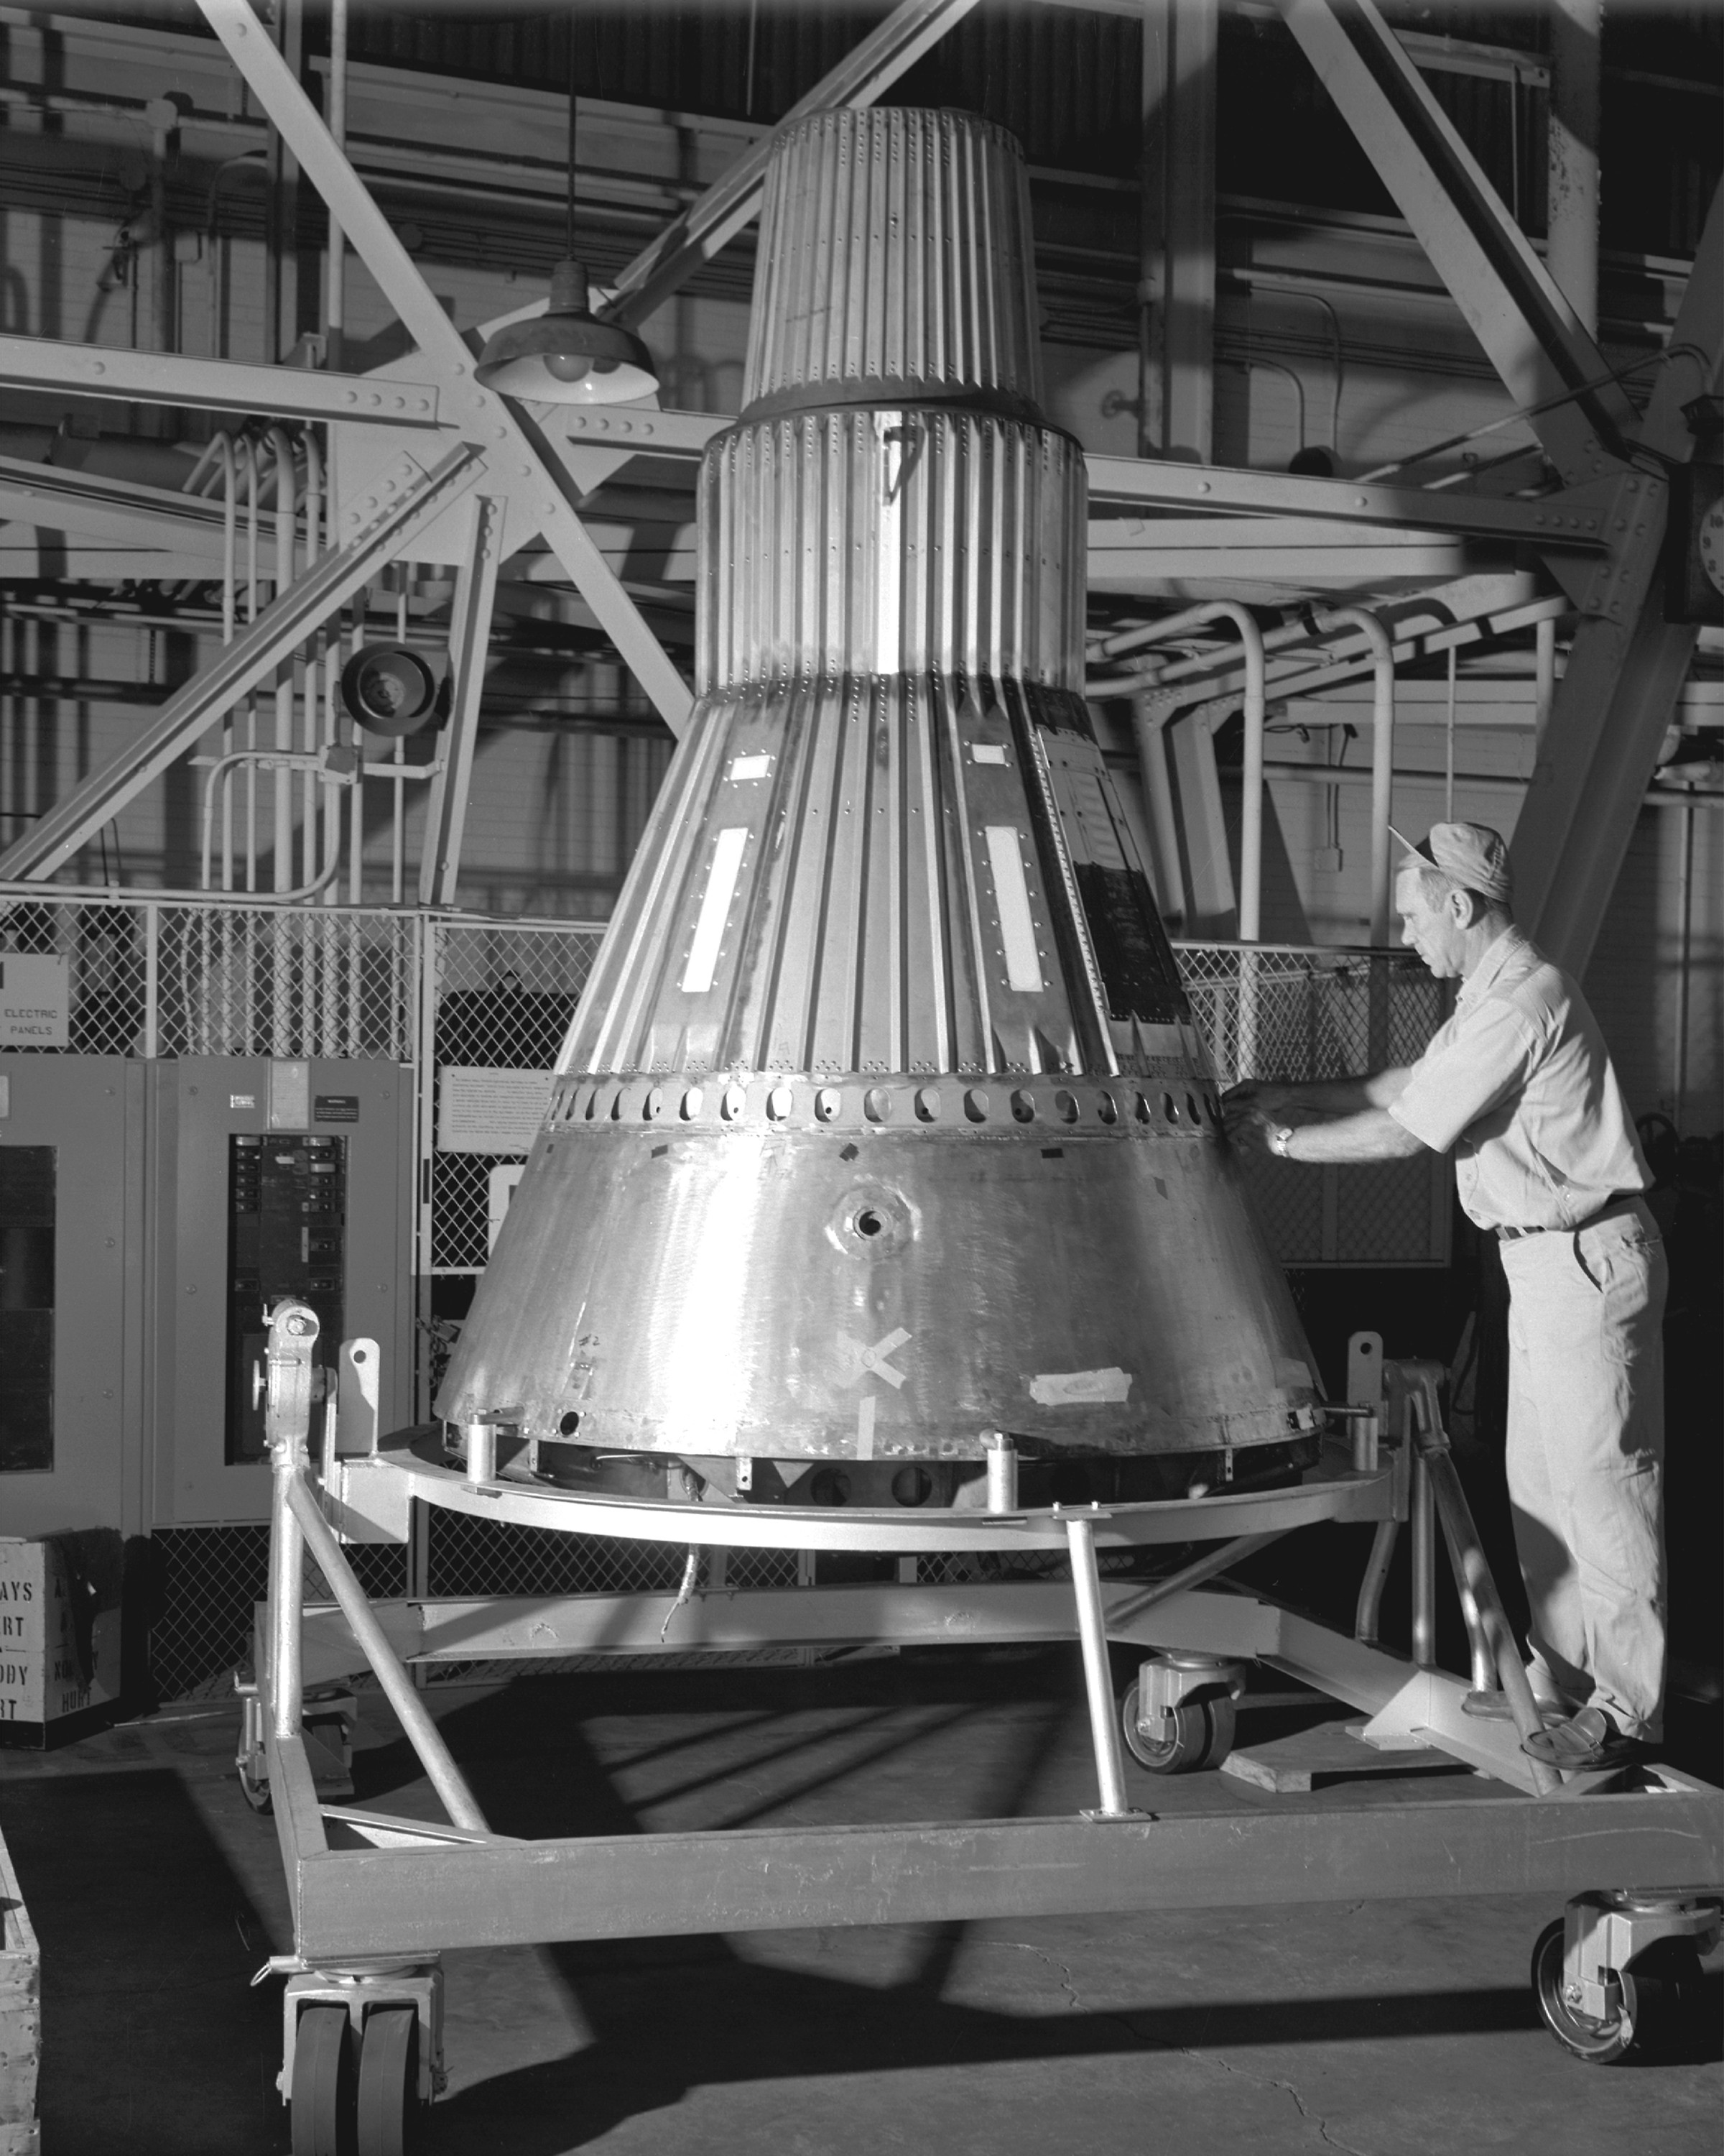
Breaking Free of Earth’s Gravity
Freedom 7:
Freedom 7 was the first American rocket to take an American Astronaut into space
Freedom 7 was part of the American space program called Project Mercury who’s goal was to place an astronaut in orbit

Slide 7
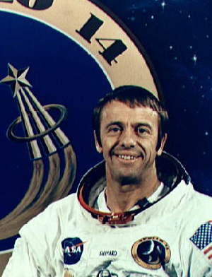
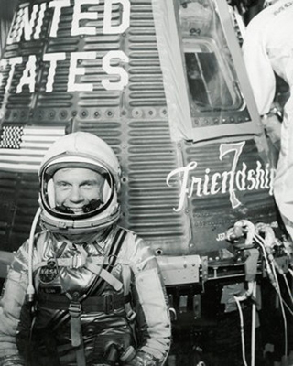
Breaking Free of Earth’s Gravity
Freedom 7 cont’d:
Freedom 7 was launched on May 5, 1961 and carried the astronaut Alan B. Shepard Jr. into space
Unfortunately Shepard ended up in a suborbital trajectory and never made it into orbit
It wasn’t until 1962 that astronaut John Glenn successfully orbited the planet

Slide 8
Breaking Free of Earth’s Gravity
Suborbital Trajectory:
A trajectory in which a spacecraft is boosted above the atmosphere and then falls back to Earth without going into orbit.

Slide 9
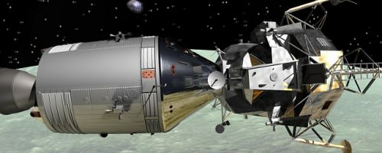
The Apollo Program
The Apollo Program was designed by United States scientists in order to send a three-person team to the Moon
The Apollo Spacecraft consisted of two parts:
An Orbiter:
The command and service modules
A Lander:
The lunar module

Slide 10
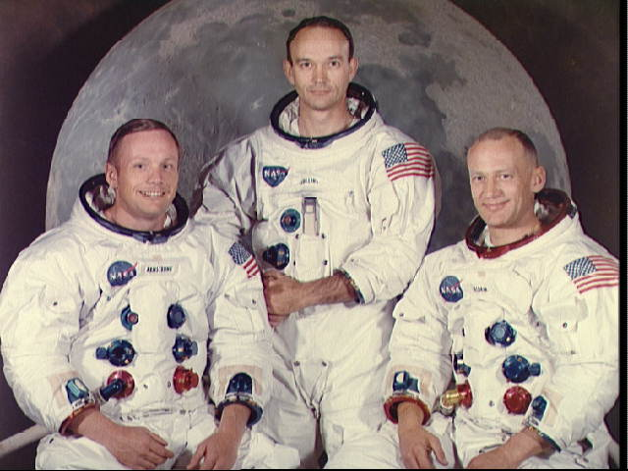
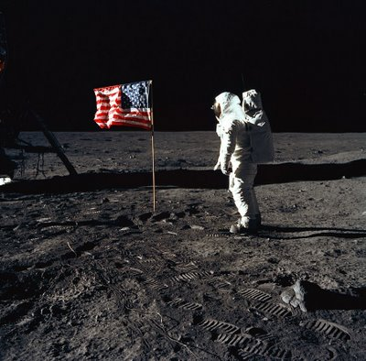
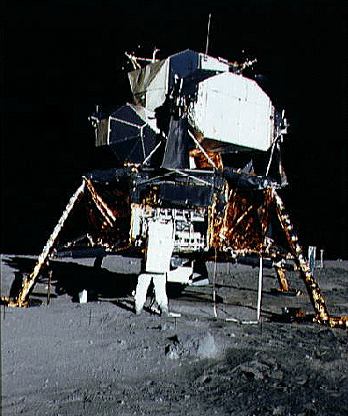
The Apollo Program
The Moon Landing:
In 1969 Apollo 11 carried the first humans to the surface of the moon
Neil Armstrong was the first to step onto the moon’s surface, followed by Edwin Aldrin while Michael Collins manned the command module in lunar orbit.

Slide 11
The Apollo Program
The Moon Landing cont’d:
As Neil Armstrong stepped onto the moon he said some of the most famous words of all time:
“That’s one small step for man, one giant leap for mankind”
Neil Armstrong One Small Step

Slide 12
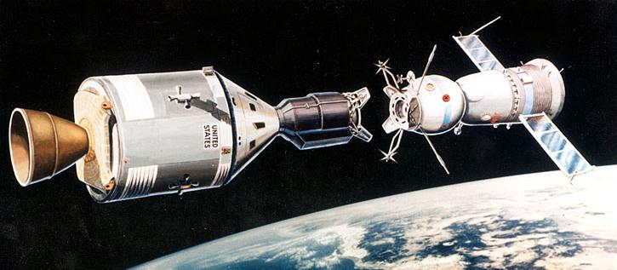
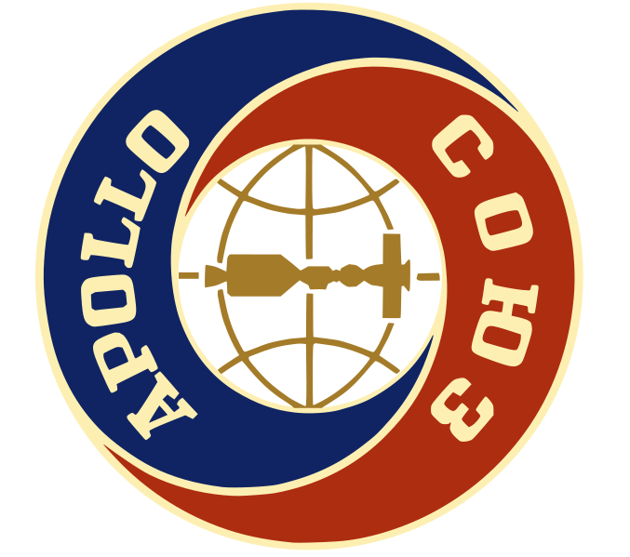
Meeting in Space
As the cold war came to an end in the 1970s the United States and the Soviet Union decided to join forces
The project they designed was called the Apollo/Soyuz test project
The goal was to create an international space station that could be used as a docking station in space
Classic NASA Film - Apollo Soyuz - #2

Slide 13
Life-Support Compatibility
In order for astronauts and cosmonauts to be able to survive in space stations certain factors needed to be considered
The most important factor is breathing
As humans breath they take in oxygen and then release carbon dioxide and water vapour

Slide 14
Life-Support Compatibility
As the oxygen depleted it need to be regenerated while the excess carbon dioxide and water vapour needed to be disposed of
The Americans and Soviet Union both disposed of carbon dioxide and water vapour using the same chemical reactions, however, oxygen production differed with each team

Slide 15
Life-Support Compatibility
 | Soviet System | American System
Cabin Atmosphere | 80% nitrogen, 20% oxygen at normal air pressure | 100% oxygen at about one-third air pressure
Advantages | Simplicity and minimal danger from fire | A switch from cabin to suit system oxygen would not subject the crew to decompression problems
Disadvatages | Cosmonauts would be exposed to potential decompression should they have to switch to a spacesuit life-support system in an emergency | Danger from fire, requirement for flameproofing all materials used in the cabin
Oxygen Replenishment | Chemical reactions with solid chemicals | Oxygen stored in high-pressure containers

Slide 16
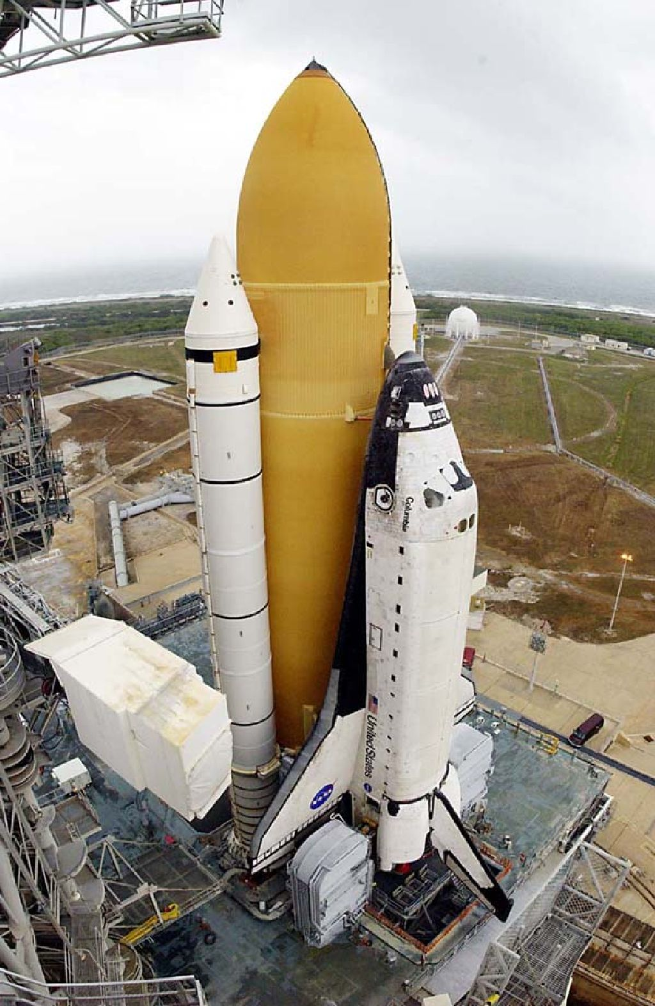
The Space Shuttle
By the end of the 1970s the United States wanted to create a Space Shuttle that could be used many times therefore lowering the cost of space travel
They succeeded and created the first Space Shuttle called Columbia

Slide 17
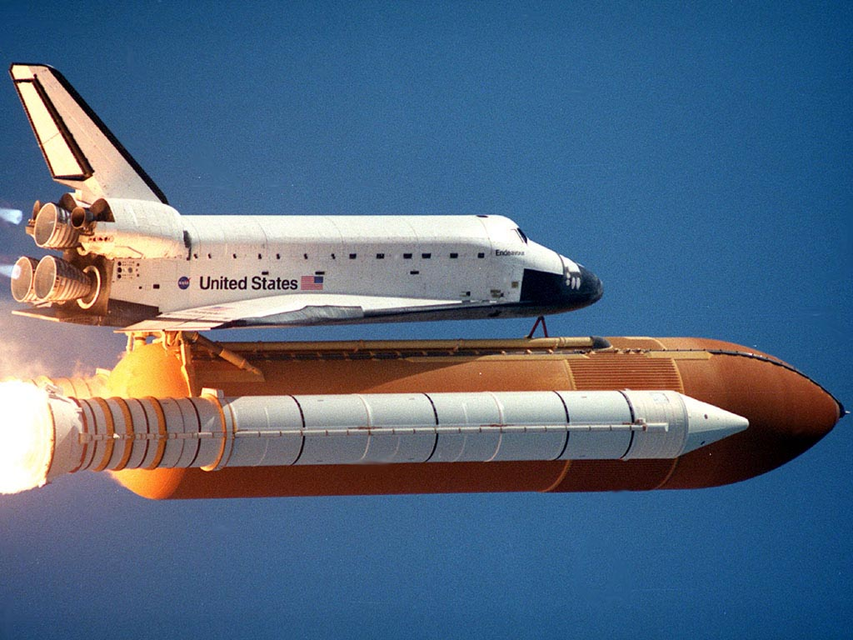
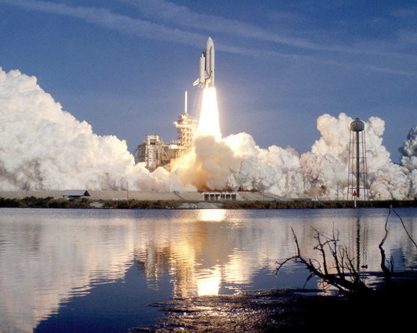
The Space Shuttle
Columbia’s First Flight:
Columbia was 56 m long and had a mass of 100 tons
It was shaped like and airplane in order to allow it to glide to Earth with no power of its own
It’s first mission to space was in 1981
|Its first flight was very successful and only minor damage to external heat shields occurred

Slide 18
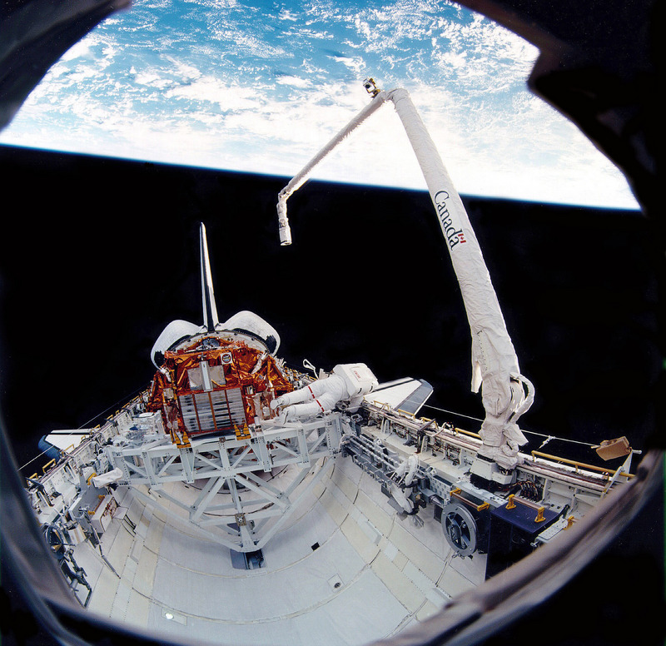
The Space Shuttle
Columbia’s Second Flight:
Seven months later Columbia flew again
This time the Canadian-built Canada Arm was tested and was successful
Not only did this prove that the shuttle could be used multiple times, it also launched Canada into space exploration

Slide 19
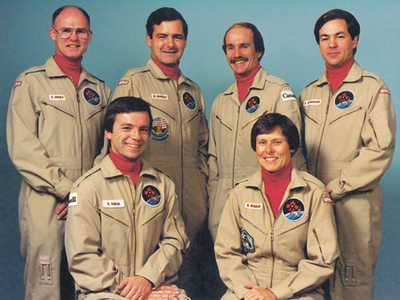
The Space Shuttle
Canadian Astronauts Join In:
In 1983 the Canadian Space Agency hired Canada’s first team of six astronauts:
Boberta Bondar
Marc Garneau
Steve MacLean
Ken Money
Robert Thirsk
Bjarni Tryggvason

Slide 20
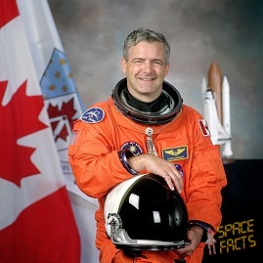
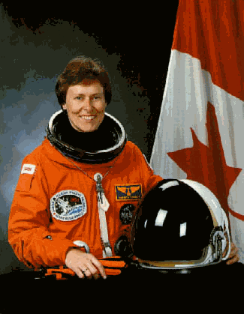
The Space Shuttle
Canadian Astronauts Join In cont’d:
In 1984 Marc Garneau became the first Canadian in space aboard Challenger
In 1992 Roberta Bondar became the first Canadian woman in space aboard Discovery

Slide 21
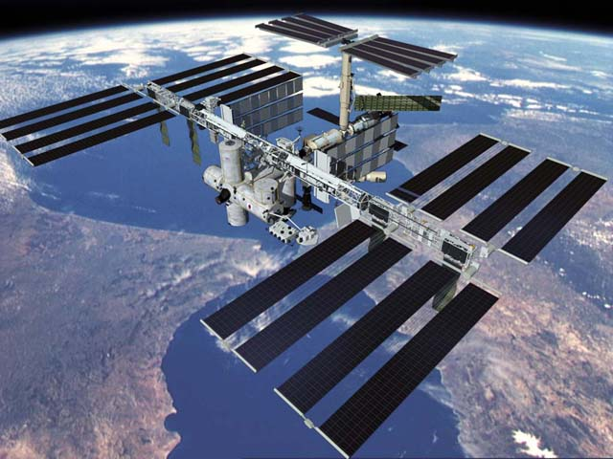
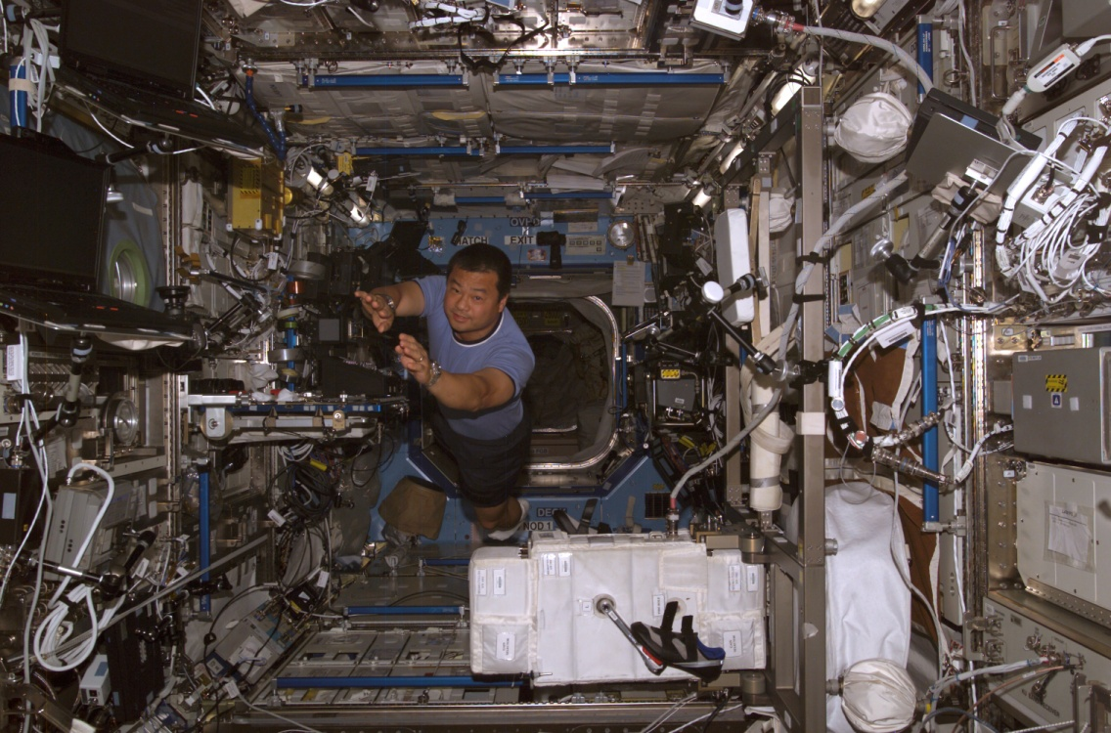
The International Space Station (ISS)
The International Space Station (ISS) is a project involving 16 nations that will one day be a massive Space Station for all of the nations to conduct research in in space

Slide 22
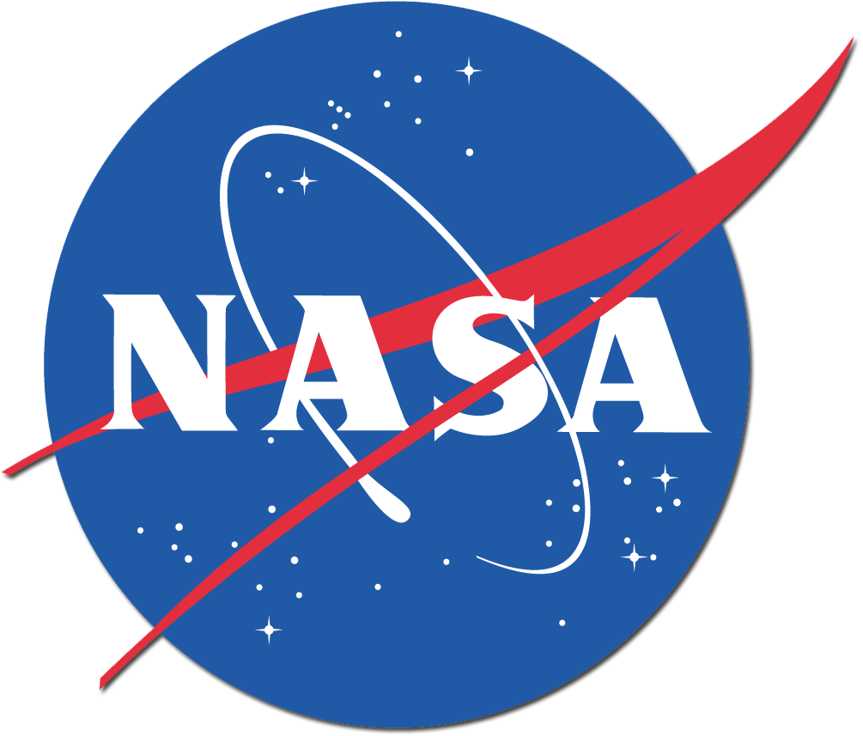
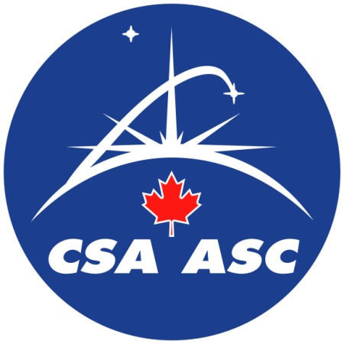
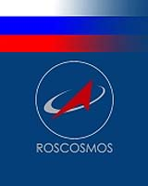
The International Space Station (ISS)
It will eventually contain six state-of-the-art laboratories for international research
Along with the United States (NASA) other major partners include Canada (CSA), the European Space Agency (ESA), Japan (NASDA) and Russia (RSA)

Slide 23
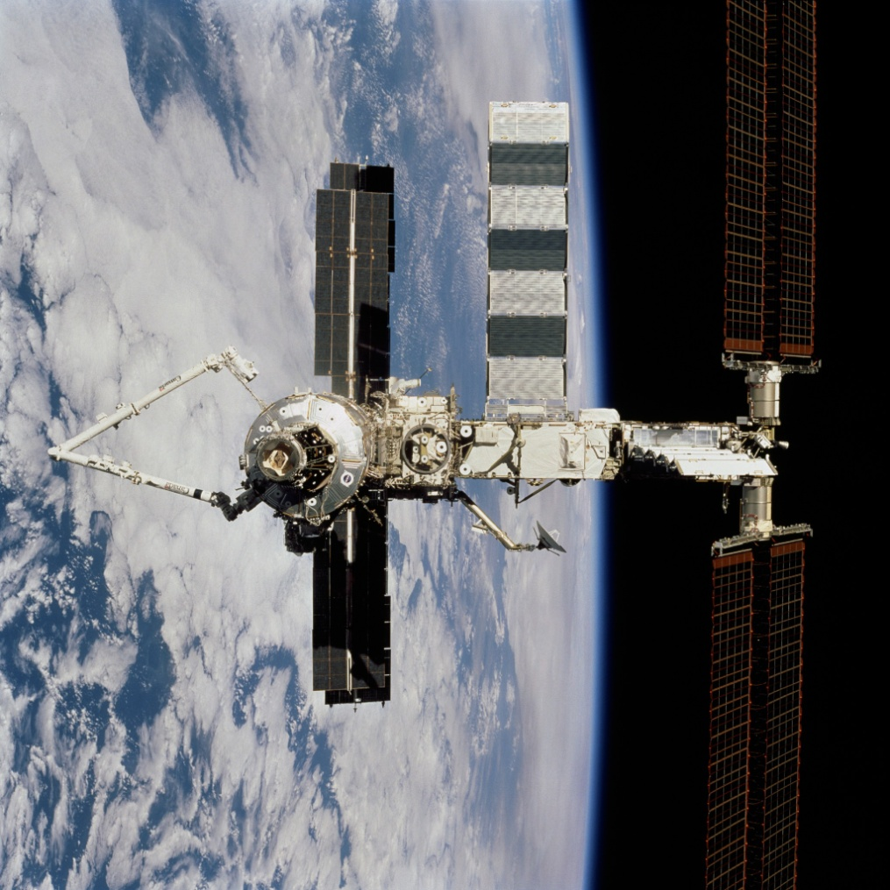
The International Space Station (ISS)
The Next Canada Arm:
Canada developed a second generation of space robotics specifically for the ISS
The device is called the Canadian Space Station Remote Manipulator System (SSRMS) or “Canadarm2”
The Canadarm2 was attached to the ISS in 2001 by Canadian astronaut Chris Hadfield
Canadarm2: How It Works

Slide 24
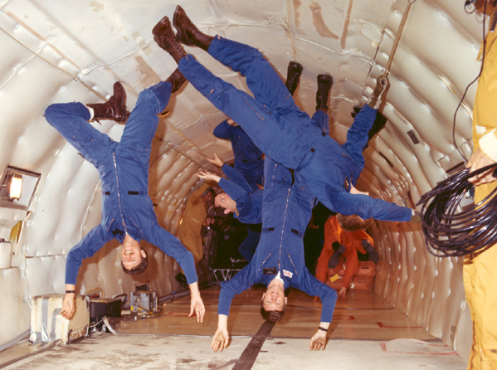
The International Space Station (ISS)
Benefits from the ISS:
Research in Biology, Chemistry, Physics, Ecology and Medicine will all be performed in the station where Gravity is greatly reduced
This research is important because it will be performed with microgravity

Slide 25
The International Space Station (ISS)
Benefits from the ISS cont’d:
Medical Benefits:
Could lead to new drugs
Long-term exposure to microgravity
Long-term exposure to external space environment
Industrial Benefits:
Could lead to stronger, lighter metals and more powerful computer chips

Slide 26
The International Space Station (ISS)
Benefits from the ISS cont’d:
Space Design:
Understanding extreme temperatures and micro-meteorites will help improve spacecraft design
Environmental Benefits:
Help to understand our own changing world and how humans are affecting it

