Slide 1
How to Read Tables

Slide 2
How to read a table
A table can be read from left to right or from top to bottom. If you read a table across the row, you read the information from left to right.
What is the following table showing?
In the Cats and Dogs Table, the number of black animals is 2 + 2 = 4. You'll see that those are the numbers in the row directly to the right of the word 'Black.' If you read a table down a column, you read the information from top to bottom. In this case, the number of cats is 2 + 3 = 5.

Slide 3
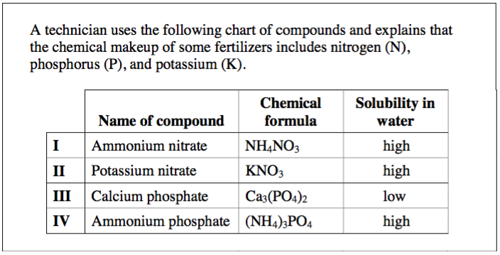
Reading a table down one column or across one row is very useful. Another great way to use a table is to pick one row header and one column header to ask a question: How many black cats are there? In this table, follow the row labeled 'Black' to the right until you find the column that says 'Cats.' The box that lines up with both headers has a number that will answer this question: 2.
Ask a question based on the following:

Slide 4
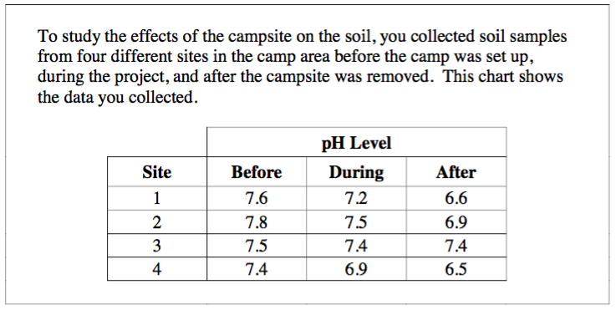
Discuss the data presented
Read and interpret what the table is showing about at least one sample. Be prepared to share this.

Slide 5
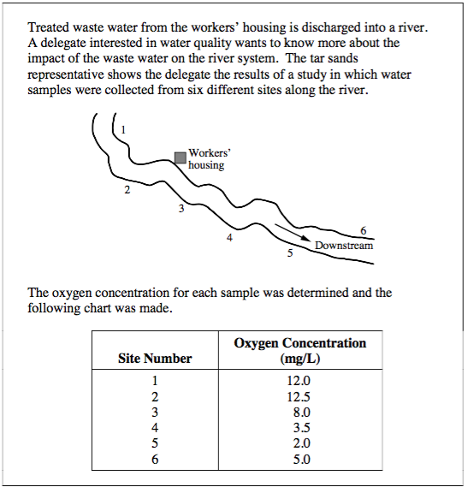
DIAGRAMS
Reading diagrams is similar to tables. Can you formulate a conclusion based on the diagram below? What about a question?

Slide 6
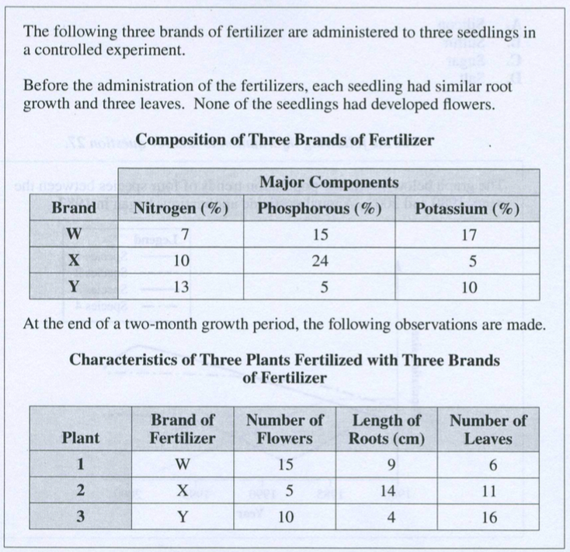
Examples
Notes:
What Questions can you create?
What is the manipulated variable?
Next Slide Relates as well

Slide 7
Based on the last table…

Slide 8
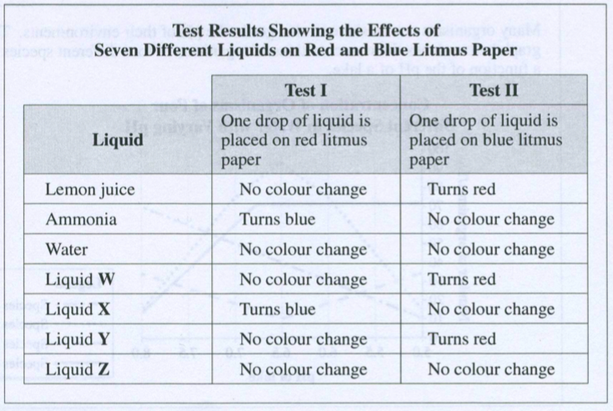
Interpret the following

Slide 9
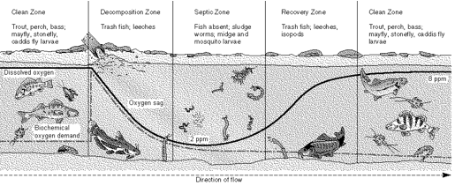
Discuss the following
What observations can you make?
What conclusions?

