Slide 1
Welcome to Grade 9
Ms. Ng’s Class
BLOG:
http://kodiaksgrade9.weebly.com/
D2L:
D2l.cbe.ab.ca

Slide 2
Today’s Schedule
Time
9:30-10:45 | Welcome, Lockers, Handbook, SMART Goals, Classroom Scavenger Hunt
10:45-11:30 | SPIRIT Activity in gym
11:30-12:00 | Classroom Scavenger Hunt continued.
12:00-12:45 | LUNCH
12:45-1:15 | Gym: Run for the Cure
1:15-2:00 | Log into D2L shell and blog Math Starter duotangs Math Starter
2:00-3:00 | Humanities (Mr. Lafferty) Will hand out forms to bring back ASAP due Friday

Slide 3
Wednesday/ Thursday
Wednesday | Thursday | Friday
Morning Mini-Timetable 1A | Morning Mini-Timetable 1B | 8:30-9:15- Attendance in Homeroom
Lunch (12:00-12:45) Sign up for Run for the Cure | Kodiak BBQ (12:00-12:45) | 9:15-9:45- Stampede Breakfast
12:45-1:50-9E Math/Sci | 1:25-1:45- Homeroom | 9:45-10:30- Homeroom
1:50-3:00 9E Humanities (Lafferty) | 1:45-2:45- Homeroom Challenges in Backfield (Don’t suck). | 10:30-10:40- Break 10:40-12:10- 9E Humanities (Lafferty) 12:10-12:40- School Wide Assembly

Slide 4
Today’s Objectives:
Introductions
Emergency Procedures
School Handbook
Timetables & Option Change
Absentees & Lates
Electronic Device Policy & Wifi
Locker Distribution
Scavenger Hunt
SMART Goals
Organize Math Starter Duotangs
Forms & Deadlines (handed out at end of day)

Slide 5
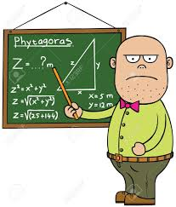
Ms. Ng (like MISS ING)

Slide 6
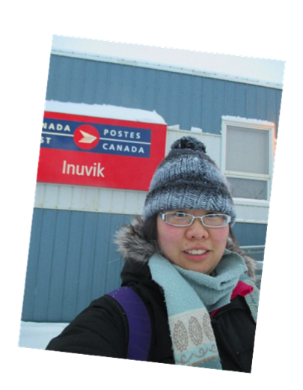
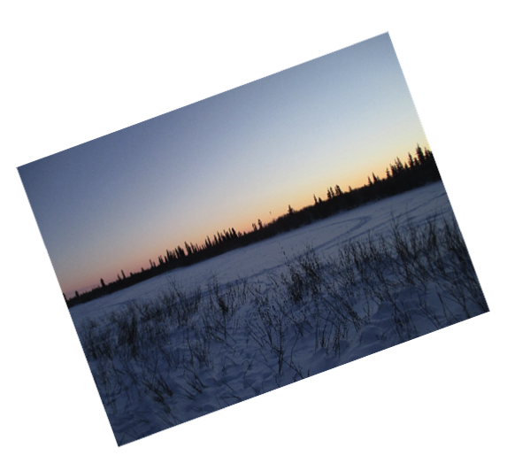
A Little Bit About Me

Slide 7
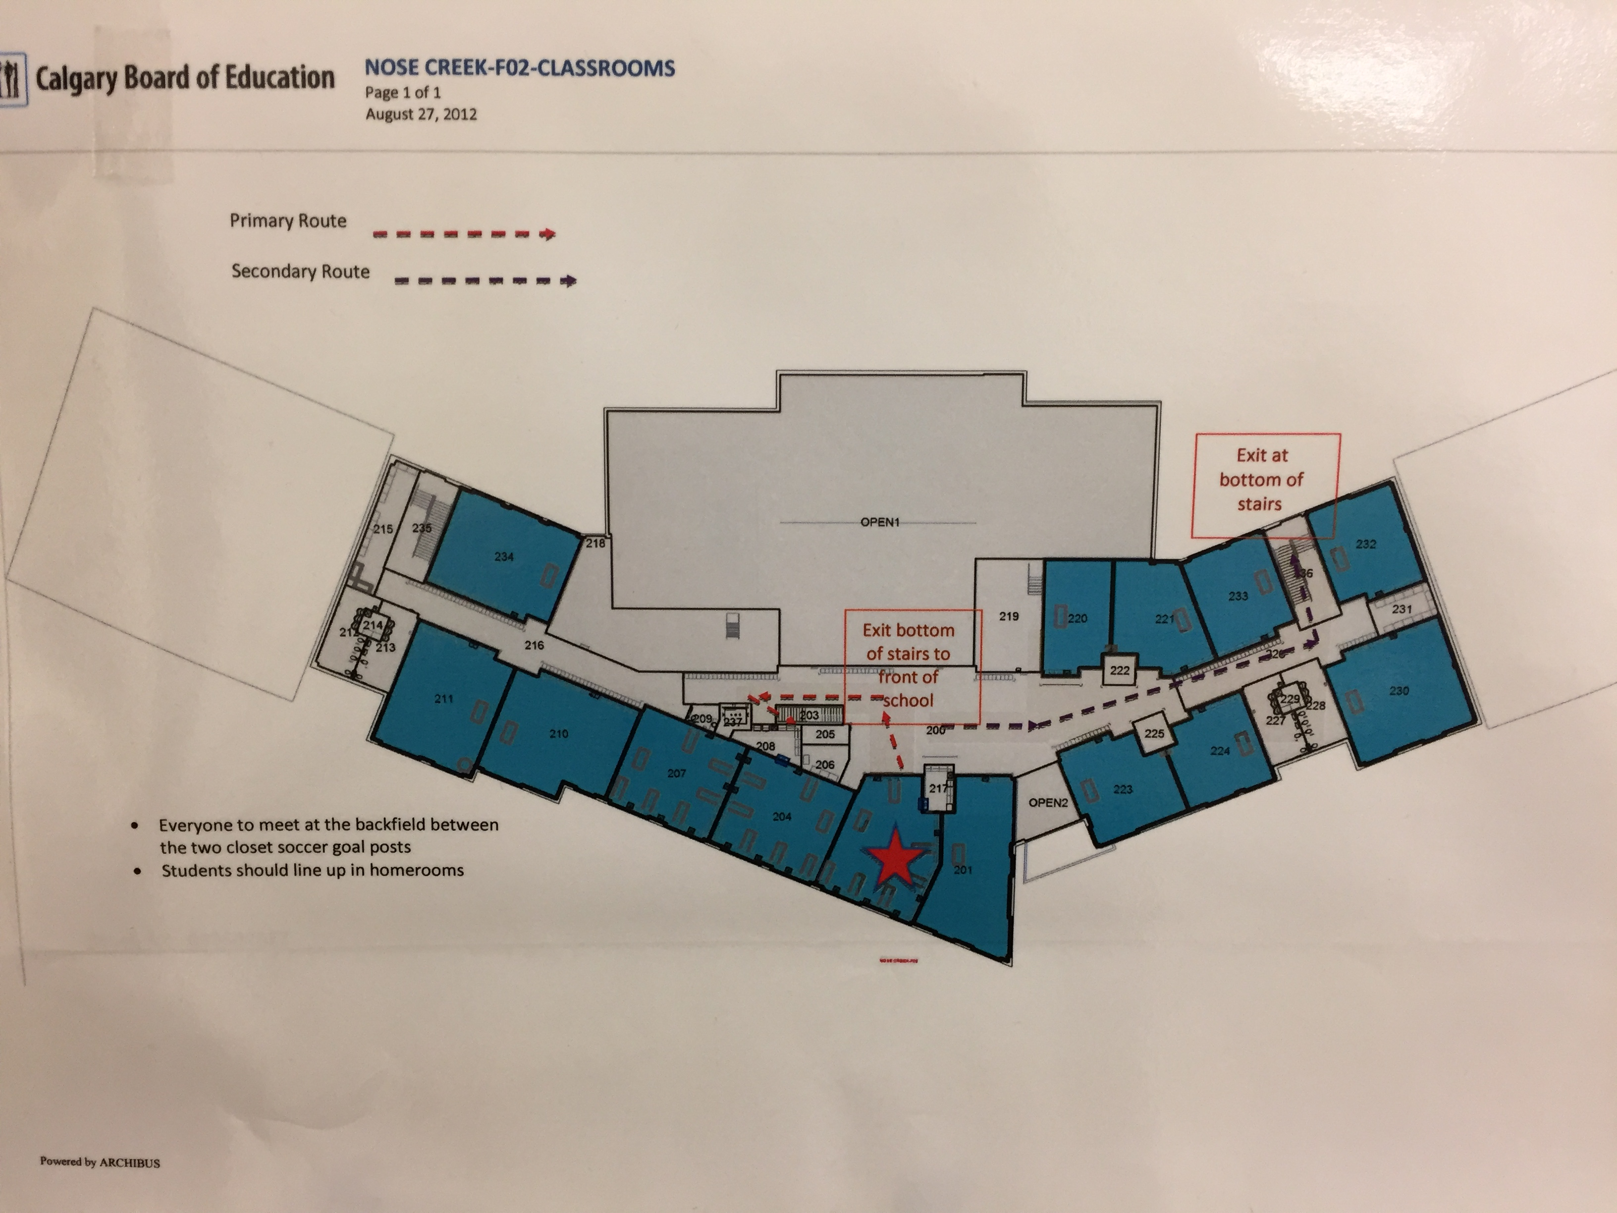
Fire and Evacuation Route

Slide 8
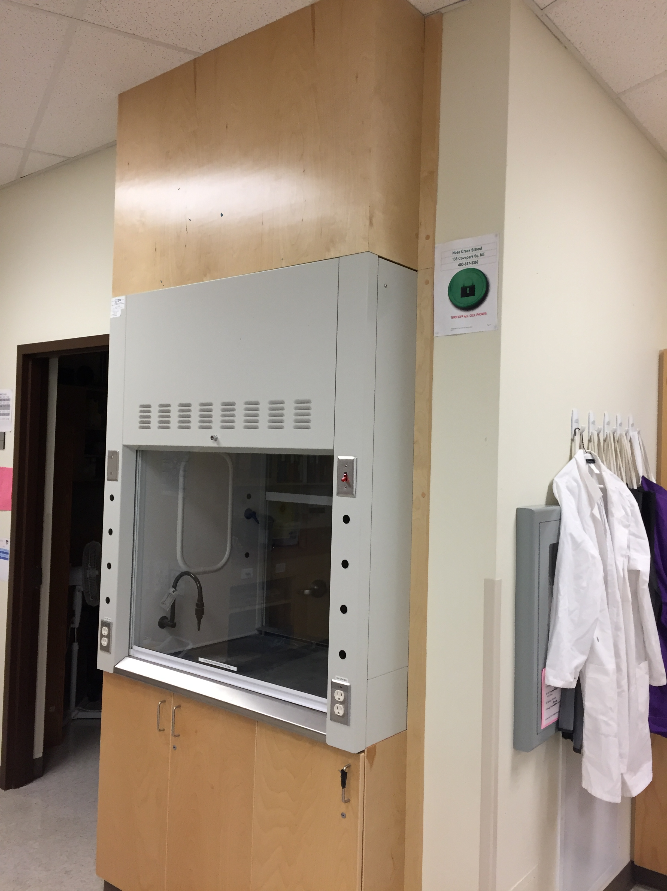
Lockdown Procedures

Slide 9
Lockers
Each student in Grades 4-9 is issued a hallway locker and lock. Non-school issued locks will be removed. Students are responsible for the cleanliness and security of their belongings – do not share your locker combination with anyone! All locks will be collected at the end of the school year, lost locks will be charged $7.00 to whom they were issued. Students may go to their lockers in the morning, at nutrition break, during lunch and after school. Students should ensure that they collect all necessary materials for their upcoming classes at these times.

Slide 10
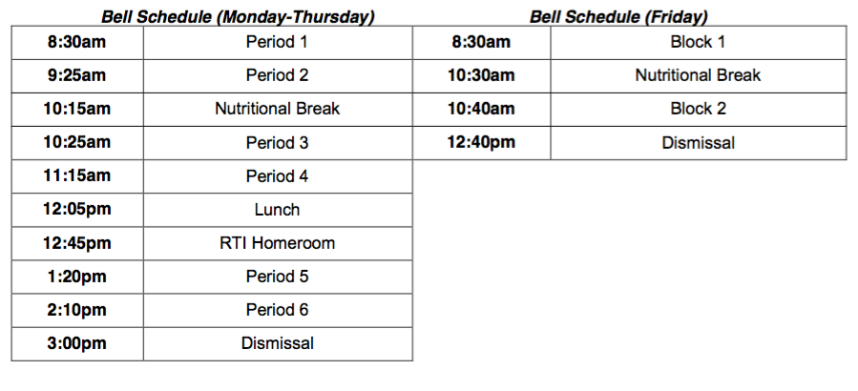
Bell Schedule
Notes:
LUNCH BELL CHANGE

Slide 11
Timetable

Slide 12
School Handbook

Slide 13
Electronic Device Policy & WIFI
http://www.cbe.ab.ca/programs/technology-for-learning/Pages/get-connected.aspx#cbe-student

Slide 14
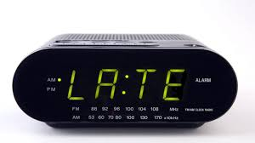
Absenteeism or Lates
Lates - Go to the office for a late slip in order to be allowed into the classroom
Absent - Have parents/ guardians call in to let the school know where you are
Holiday - let the school and your teacher know ahead of time so we can keep you up
Students are responsible for missed work!

Slide 15
General Expectations
Participate! If you have something to contribute, raise your hand and avoid side conversations.
Be respectful
This is a safe space!
Notes:
POPSICLE STICKS

Slide 16
What you can expect from me
Respect
Clear expectations from students
Notes, assignments, quizzes will be posted on D2L Daily.
Reminders-sign up
Also check for objectives

Slide 17
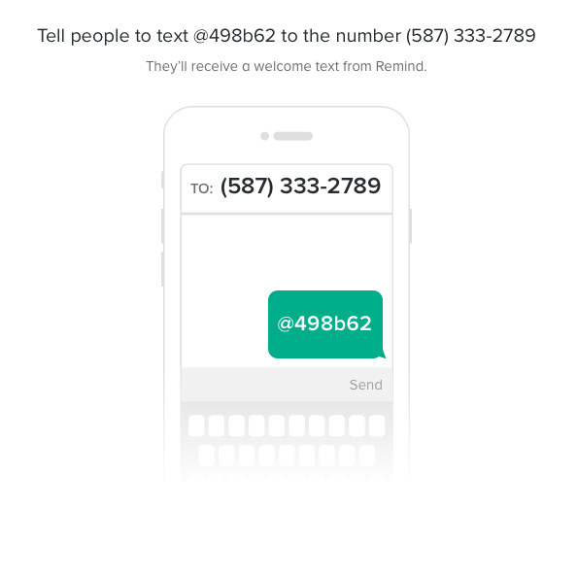
Remind 101
Text or use the Remind 101 App
Sign up by EITHER: https://www.remind.com/join/498b62 OR Text
@498b62 to
587-333-2789
PARENTS CAN SIGN
UP TOO!

Slide 18
Paperwork
Write your number on the top right hand corner of all paperwork.
Get the forms signed and returned by tomorrow.

Slide 19
Science Bingo!
Find someone in the classroom who knows what the word/picture is or can answer the question. You may only use a person only once (including Ms. Ng).
Please write the answer and have the person sign the square.

Slide 20
Get To Know You Activity
SMART Goals
S
M
A
R
T
Hand in to Ms. Ng when done. I will discuss your goals with you in the upcoming days.

Slide 21
Math Starter Duotangs
Each Math class we will start with a math starter problem.
You will record these problems in your Math Starter duotang
You will need to supply looseleaf for your duotangs.
Do not take your duotangs home! They should be handed in at the end of each day.

Slide 22
Math Starters
Copy down the Math Starter in its entirety onto a new page each day.
This will leave plenty of room for you to show your work
Keep your work in order,and date and label with the title. Example:
September 4, 2018 Natural Number Pattern
I will check your math-starter notebook periodically. I may offer comments and suggestions about your work. If you want, write brief notes to me in your notebook, and I will respond to you. We can carry on a dialogue about your progress in math.

Slide 23
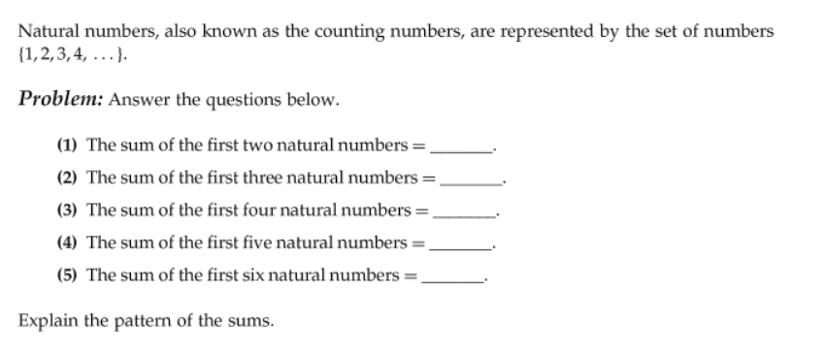
September 4, 2018 Natural Number Pattern

Slide 24
Blog and D2L
BLOG:http://kodiaksgrade9.weebly.com/
D2L: d2l.cbe.ab.ca
-The BLOG will be updated on a weekly basis. It will update both your parents/guardians and yourselves of what your learning objectives were during the week.
-D2L will be updated daily. Videos, Notes, Assignments, Announcements, Online Quizzes
Check that you can log in.

