Slide 1
Canadian Immigration: By the Numbers
Quantitative Analysis of Population and Immigration Trends in Canada and their Effects on the Economy

Slide 2
Key Ideas
NATURAL INCREASE
Change in the size of population owing to the difference between the number of births and the number of deaths during a given period
MIGRATORY INCREASE
Change in the size of population owing to the difference between the number of migrants who settle within a geographic area and the number of migrants who leave that same area during a given period {for our discussion - immigration}

Slide 3
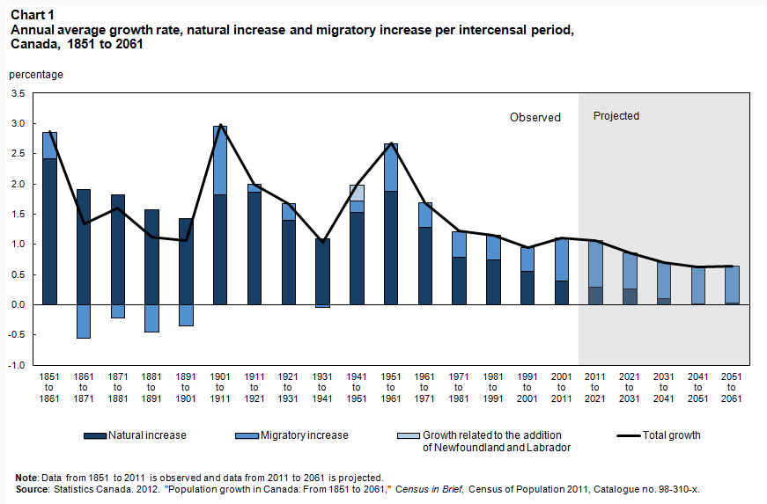
Extrapolation
1949
Source http://www.statcan.gc.ca

Slide 4
Strong population growth in 3 periods – why?
Prior to Confederation (1851-1861)
-high fertility rates
-large numbers of immigrants settling in the West
Early in the 20th century (1901 - 1911)
-relatively high fertility rates (5 children/woman)
-high immigration numbers, mostly from Europe
3) After World War 2 to the early-1960’s
-refugees / stateless people /economic migrants
-rise in fertility rates resulted in a ‘baby boom’
-high immigration due to other geo-political
world events

Slide 5
Noticeable decline in overall population growth starting in the 1960’s to the present – why?
Rapid decrease in fertility rates, which has
remained constant (less than 2 children/woman)
(change in societal “norms”?)
Steady rise in the number of deaths, partly due
to an aging population
So ..… the engine of Canada’s population growth since 1999 has been, and continues to be, migratory growth.

Slide 6
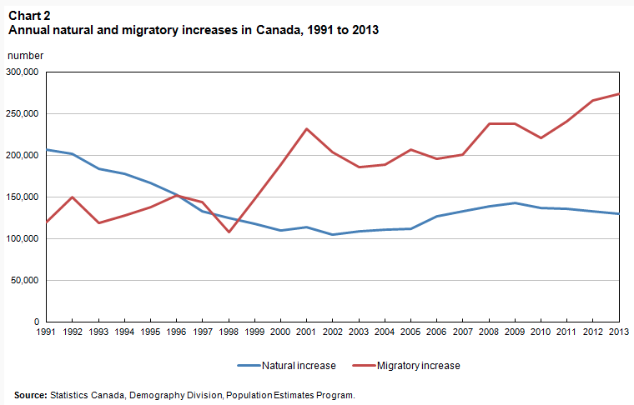
Migratory Increase – the major engine of population growth since 1999
http://www.statcan.gc.ca

Slide 7
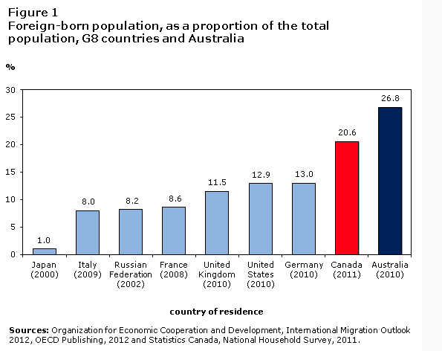
**Immigrant Source Countries have changed over the years.
Source http://www.statcan.gc.ca

Slide 8
Future population growth could rely even more on migratory increase because:
Mathematical models suggest that natural increase will continue to decline (stagnant fertility rates, more natural deaths vs fewer live births) **regional exception is Nunavut
Accelerated population aging betwn 2011-2031 so the number of natural deaths will increase

Slide 9
By 2031, migratory increase could account for more than 80% of Canada’s population growth (currently at ~ 67%)
Without a sustained level of immigration, Canada’s population growth could be close to zero within 20 years.
Source http://www.statcan.gc.ca
SO WHAT??

Slide 10
CONS of increased Migration
(Pros of population decrease?)
1.
2.
3.
4.

Slide 11
PROS of increased Migration
(Cons of population decrease?)
1.
2.
3.
4.

Slide 12
“Weaker economic growth over the long term will limit the amount of revenue that governments in Canada collect over the forecast period at a time when the aging of Canada’s population will require significantly more expenditures … (health care spending, Canada Pension Benefits and OAS Benefits) Higher immigration can increase the growth of Canada’s labour force over the longer term and generate higher economic growth”.
Source: thestar.com
Does POPULATION GROWTH lead to ECONOMIC GROWTH which leads to PERSONAL WEALTH?

