Slide 1
How Bills Become Laws

Slide 2
Discussion Questions
Which branch of government has the power to create new bills/laws?
More specifically, what are the jobs within the sections of that branch of government?

Slide 3
Discussion Questions
The legislative branch of government can propose all the bills it wants to, but only some of them will survive the long and tedious journey to becoming a real law.

Slide 4
First Reading
Once a bill has been proposed, the first step is what is called a “First Reading.” The bill is printed out and distributed to members of the House of Commons. There is no debate, no vote, just a reading of the proposed bill; Hence why this is called the “First Reading.”
This is when Bill is first introduced to the House of Commons.
BILL

Slide 5
Guess what comes next?

Slide 6
Second Reading
All involved have now had the chance to peruse the new bill.
It comes back to the House of Commons and there is a debate and a vote on the principle of the bill.
The PRINCIPLE of the bill, they are not voting to pass the bill, just deciding whether they are going to pay any attention to the bill or not.
Is this even worth our time?
MPs

Slide 7
Two options after the SECOND READING

Slide 8
Two options after the SECOND READING
Or…

Slide 9
Guess what comes next?

Slide 10
If the bill is approved to move on to…
The Committee Stage

Slide 11
Committee Stage
This is a detailed study of the bill.
A committee of MPs or Senators study the bill further. They investigate the bill with the help of witnesses, people directly impacted, FNMI elders, scientists, specialists… people who are experts in the field.
They would then issue a REPORT on the bill with any recommendations that they may have.
This may be where sneaky Lobbyists influence government.

Slide 12
Committee Stage
There are a few things that could happen with the committee stage:
The bill gets accepted.
The bill gets amended.
The bill gets rejected.
If the bill gets amended or accepted, it goes to the report stage.
I’m so happy you weren’t rejected Billy!
If it is rejected, it is DEAD!

Slide 13
Report Stage
In this stage, there is another discussion, debate, and vote on the proposed bill / on the bill and its amendments.

Slide 14
Guess what comes next?

Slide 15
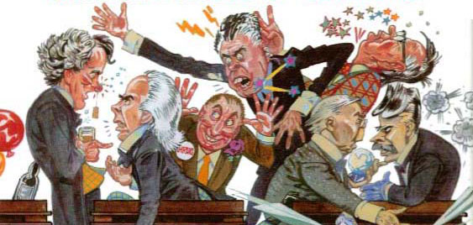
Third Reading
After the Report Stage, the bill moves forward to a Third Reading regardless of whether or not there were any amendments made.
Again, here the MPs or Senators discuss, debate, and then vote on the FINAL FORM of the bill.

Slide 16
Trust the Process
First
Reading
Second
Reading
Study
Bill
Committee
stage
Amend
Bill
Report
stage
Third
Reading
Accept
Bill
Accept
Bill
The Senate usually accepts bills, although sometimes they do amend them. Bills are rarely rejected by the Senate.

Slide 17
Guess what comes next?

Slide 18
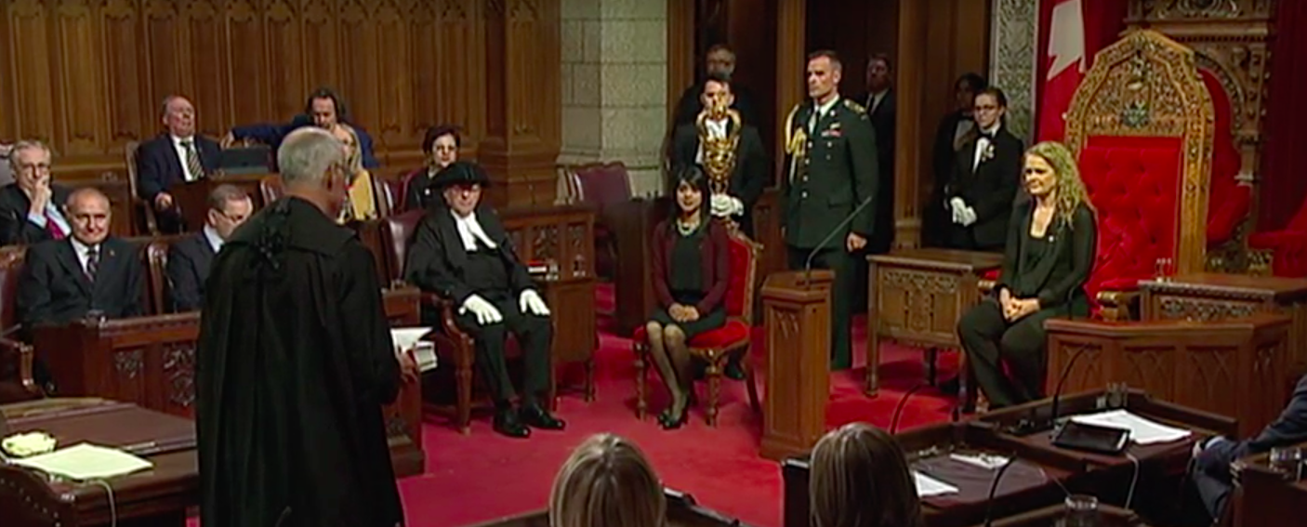
Lastly, the bill still needs to be approved of by Canada’s monarchy. Typically, the Governor General is the power that give Royal Assent to a bill, which changes it into a law.

Slide 19
One last overview
The bill goes through a First Reading
The bill is sent to a Second Reading where it is debated and voted on
The bill then goes to a Committee Stage to be studied and amended
Then comes the Report Stage where there is a debate and vote on the amendments made to the bill
Finally there is a Third Reading in which there is a final debate and vote.
The bill is then sent to the senate to go through the same steps
At the very end of everything, if approved, the bill becomes a law after the Governor General gives Royal Assent

