Slide 1
Environmental Chemistry

Slide 2
What do you think we will study in environmental chemistry?

Slide 3
Essential Nutrients

Slide 4
Essential Nutrients
Key vocabulary
Organic compound
Inorganic compound
Macronutrient
Micronutrient
Carbohydrate
Lipids
Protein
Nucleic acids
Optimum amount

Slide 5
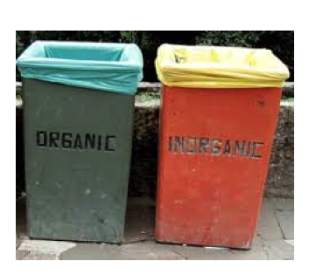
Essential Nutrients
Your body requires certain chemicals/nutrients to remain healthy.
How we take in these nutrients?
Two types of nutrients
Organic
Contain the
element carbon
Inorganic
Everything else

Slide 6
Organic Versus Inorganic Nutrients
ORGANIC-contain carbon element
Examples are carbohydrates, lipids, proteins and vitamins
NOTE that the term organic compounds refers to anything with the carbon element not just nutrients. E.g. fossil fuels are also organic compounds
INORGANIC-everything else
Such as minerals like calcium and iron

Slide 7
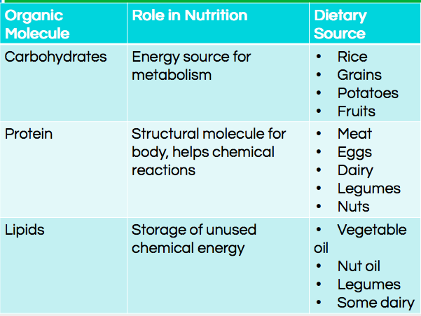
Organic Nutrients

Slide 10
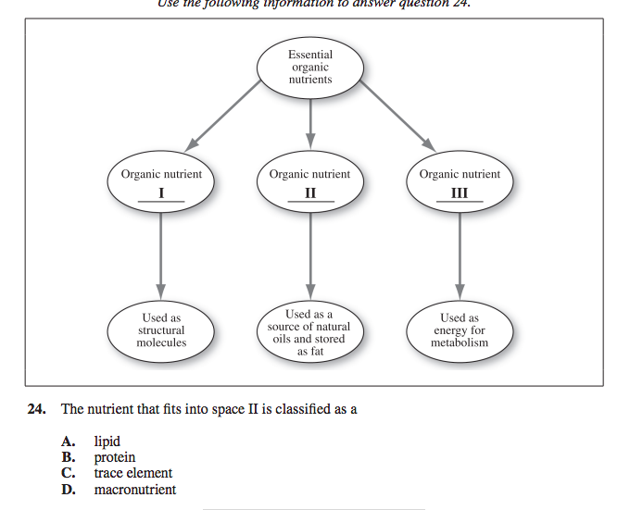

Slide 11
Inorganic Essential Nutrients
Minerals
Macromineral-You need a lot of this mineral
Micromineral -You only need a little bit to be healthy (aka trace elements)

Slide 12
Optimum Amount
The amount that provides the organism with the best health

Slide 13
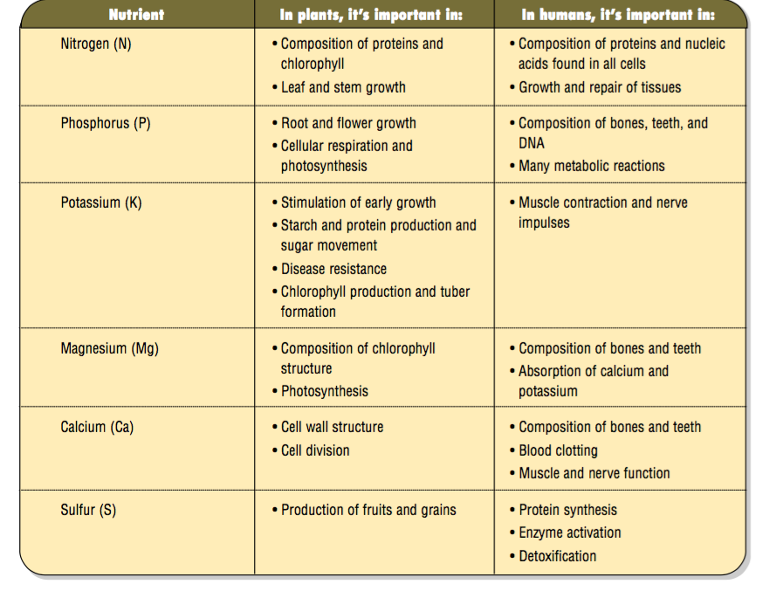
Macronutrients versus Micronutrients

Slide 14
Be prepared for a lab tomorrow We will be working with reagents what
How can you be prepared for tomorrow?
Read the lab! Posted on D2L
Dress appropriately for working with chemicals

Slide 15
Homework #2
What is one of your favorite foods?
Look up the nutritional information for this food.
Take a photo of the nutritional information.
If the photo is organic/produce or a prepared meal you may need to Google this.

