Slide 1
ENVIRONMENTAL CHEMISTRY

Slide 2
Unit Overview: Where Biology and Chemistry Meet
In Matter and Chemical Change, we looked at properties and changes of matter and how chemistry can be used to explain them.
This unit we, will look at chemistry as it relates to biology and the environment.

Slide 3
Let us begin…
What does chemistry have to do with biology?
We are all made of chemicals
Food also made of chemicals
Broken down by digestive system into molecules that are absorbed into blood
These chemicals or nutrients are used for:
Energy
Growth
Body- building
Cell repair

Slide 4
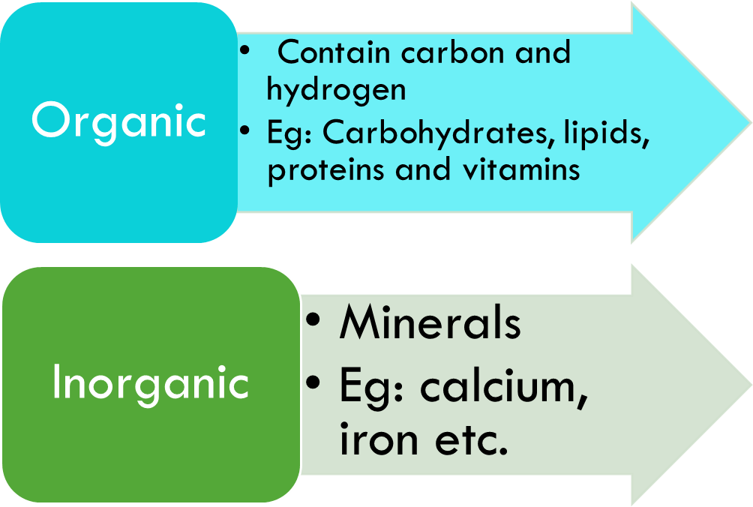
Nutrients- essential for life
Nutrients can be organic or inorganic

Slide 5
Organic Compounds
Organic Molecule | Role in Nutrition | Dietary Source
Carbohydrates | Energy source for metabolism | Rice Grains Potatoes Fruits
Protein | Structural molecule for body, helps chemical reactions | Meat Eggs Dairy Legumes Nuts
Lipids | Storage of unused chemical energy | Vegetable oil Nut oil Legumes Some dairy

Slide 6
Elements for Healthy Bodies: Minerals
Minerals you need a lot of is called a macromineral
Minerals you only need a little of are called trace elements, which are found in enzymes and vitamins
All living things need 16 naturally occurring elements
Plants need 18 elements
We need 22 elements

Slide 7
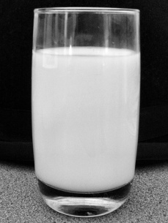
Elements for Healthy Bodies:
Calcium
Phosphorus
Needed for strong bones and teeth
Nerve conduction
Muscle contraction
Blood clotting
Bone formation
Forms compounds that store and release energy (ATP)

Slide 8
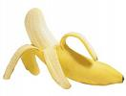
Elements for Healthy Bodies:
Magnesium
Potassium
Component of Bones and teeth
Essential for enzyme function
Helps regulate nerve function
Helps regulate nerve signals and muscle activity (heart rate)
Protein formation
Regulates acid/base balance in body

Slide 9
Elements for Healthy Bodies: What is one crucial role for….
Sulphur?
Used in some amino acids
Iron?
Red blood cells, regulates oxygen transport
Iodine?
Major part of thyroid hormones that regulate metabolism

Slide 10
Getting these Minerals
As humans, we cannot extract the mineral directly from the ground
But plants can… and do
Root hairs specially designed to uptake and concentrate these minerals
They are then transported to other parts of the plant where they are used to create organic compounds such as proteins, lipids and vitamins.
Without plants, we would not be able to obtain the nutrients we need.

Slide 11
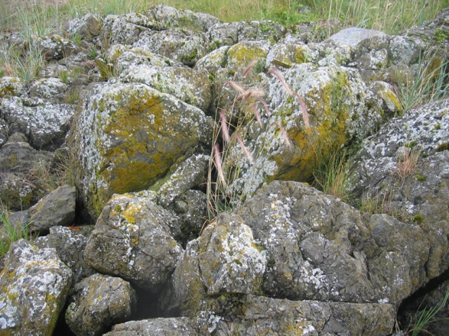
Substrates
Other organisms get their minerals through absorbing them from a substrate
A substrate is a material on which an organism moves or lives.
Some organisms attach themselves to the substrate, others obtain their nutrients from their substrate.
For example – the lichens in this photo are using the rocks as a substrate.

Slide 12
Fertilizers: Nutrients for Plants
Often, we help plants grow by giving them fertilizer
Fertilizers imitate nitrogen cycle, adding nitrates, ammonia and urea
Phosphorus provided as phosphate compounds
Potash acts as source of potassium
Numbers on bag indicate percent of each substance
Notes:
12

Slide 13
Impact of Using Fertilizers
Use of artificial fertilizers has increased amount of nitrogen in environment as much as 140 million tonnes/year
What are the pros and cons of this use?

Slide 14
Pros
Cons
Increased plant growth
Land not normally suitable for farming, can yield large crops when
High yield crops plants
Fertilizer used
Properly watered
Fertilizer and water can be an expensive price for productivity
Single crop = increased chance of impact by disease
Pesticides can be used to reduce loss of crops, but are not without cost or environmental impact
Eg: Harmful Algal Blooms

Slide 15
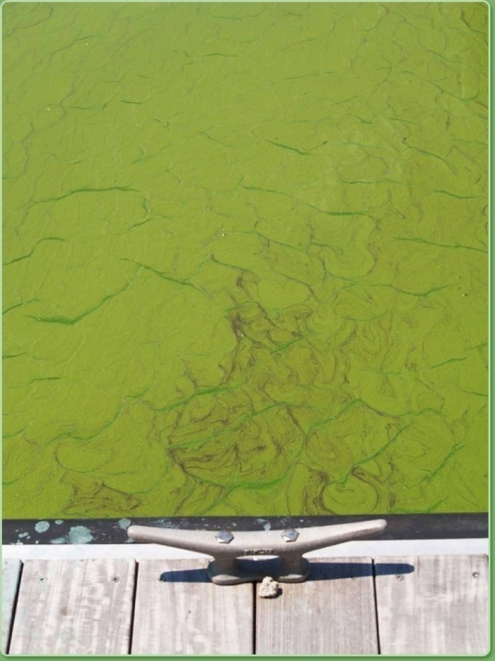
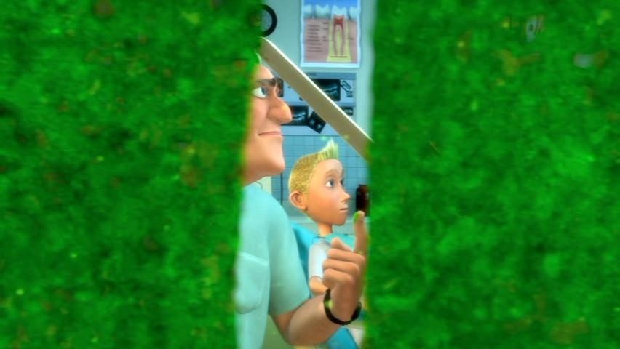
Harmful Algal Bloom
Rapid growth of algae that can deplete the oxygen dissolved in the water and block sunlight required by other organisms in the aquatic ecosystem
15

Slide 16
Summary
Living things need nutrients to survive
These nutrients can be organic or inorganic
We obtain our nutrients from our food which includes plants
Plants are capable of absorbing minerals from the soil, and using them to make proteins, lipids and vitamins
Fertilizers are one way that can be used to enhance plant growth, but their use in not without impact

Slide 17
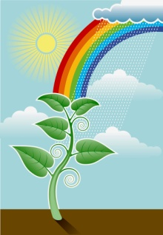
Last Class
This Class
Looked at nutrients needed for living things
Organic vs Inorganic Nutrients
Exit slips from last class
Nitrogen Cycle
Investigate the use and movement of pesticides and their impact on the environment
Bioaccumulation
Biomagnification
DDT

Slide 18
Pesticides
Three types of pesticides
Herbicides: these chemicals are designed to kill plants. Some are selective (eg. Killex), while others are not (eg. Round-up)
Insecticides: these chemicals are designed to kill insects eg. Raid, DDT, dieldrin
Fungicides: these are designed to kill fungus

Slide 19
Ingestion vs Absorption
Ingestion – taking in a material. For us, this is equivalent to eating
Absorption – this can occur in several ways:
Digestive tract
Respiratory tract (after inhalation)
Skin

Slide 20
DDT
DDT (dichlorodiphenyltrichloroethane) is an insecticide that kills mosquitos and other insects.
Originally seen as great, was going to solve the problem of malaria
Hand unforeseen consequences higher up the food chain due to BIOACCUMULATION and BIOMAGNIFICATION
Birds feeding on insects were laying eggs with shells too thin to allow chicks to survive.

Slide 21
Bioaccumulation vs Biomagnification
Bioaccumulation is an increase in concentration of a material from the environment over time in an organism in a food chain
Biomagnification is an increase in concentration of a pollutant from one link in a food chain to another
In order for this to occur, the pollutant must be long-lived, mobile, soluble in fats, and biologically active

Slide 23
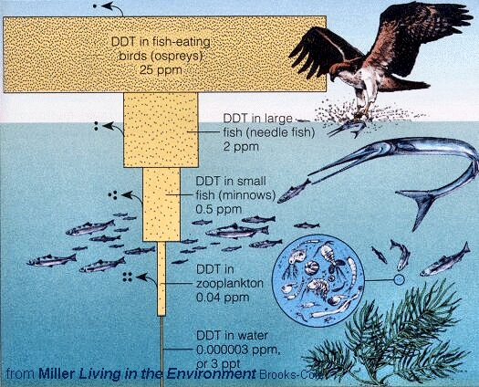

Slide 24
DDT Restriction
Four reasons restriction of DDT has been a struggle:
DDT helped reduce malaria incidence; incidence increased again after DDT banned
Replacements not as safe or effective
Substitutes are more expensive
Pesticide resistance is on the rise

