Slide 1
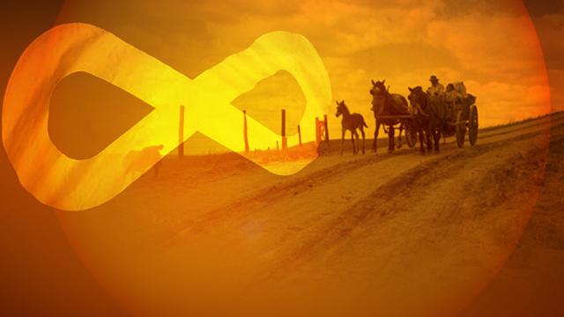
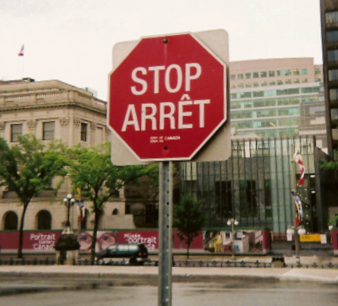
Collective Rights

Slide 2
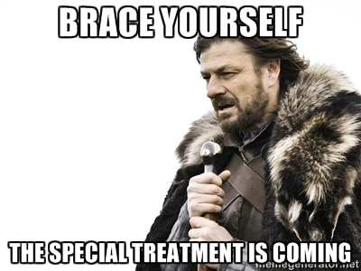
Notes:
100% on unit test or candy / other sort of special treatment to specific groups – people with glasses, people with blond hair, pink shirts, etc.

Slide 3
Stoney Trail
http://www.cbc.ca/news/canada/calgary/s-w-ring-road-deal-approval-historic-says-tsuu-t-ina-chief-1.2251344

Slide 4
To What Extent Should Canadians Support the Rights Present in the Canadian Charter of Rights and Freedoms?
Notes:
What Rights Should We Have?

Slide 5
Review
What are our individual rights?
Who is entitled to these rights?

Slide 6
What Collective Rights are Present in the Charter?
Notes:
What Rights Should We Have?

Slide 7
What Are Collective Rights?
Special rights held by Canadians who belong to certain groups:
English and French speakers
First Nations
Metis

Slide 8
What Are Collective Rights?
Inherent Rights:
Powers which people are justly entitled
Rights that existed before Canada

Slide 9
Inherent Rights
Notes:
How is the right to hunt inherent to First Nations?
What is an inherent right which you have?

Slide 10
What Are Collective Rights?
Meant to:
Protect unique cultures of Canada’s founding peoples
Restore equality for founding peoples
Notes:
Who might that equality have been taken away from?

Slide 11
Canada’s Founding Peoples
First Nations
Metis
French
English
Canada could not exist without contributions of each
Notes:
If all of these people did not cooperate, Canada would probably not exist today – we would probably be American

Slide 12
What Does the Charter Say About Collective Rights?
Notes:
Competition – candy for the first group to find the correct phrases from the Charter relating to collective rights

Slide 13
What Are Each Group’s Collective Rights

Slide 14
First Nations Rights
Anything mentioned in Treaty
Pg. 125:
Healthcare
Education
Hunting / Fishing Rights
Land reserves
Annuities
($5 / year)

Slide 15
Numbered Treaties

Slide 16
Metis Rights
Right to be a First Nation
Hunting and Fishing Rights
Other rights under negotiation

Slide 17
Language Rights
Right to:
Communicate with the government in English or French
Be publically educated in English or French

Slide 18
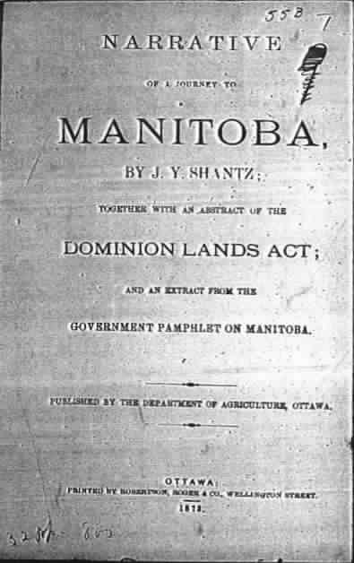
Challenges of Collective Rights
Notes:
What do you think a challenge of collective rights may be based on these three documents? Look at the dates, the formats, etc. – Very old – hard to interpret today

Slide 19
Challenges of Collective Rights

Slide 20
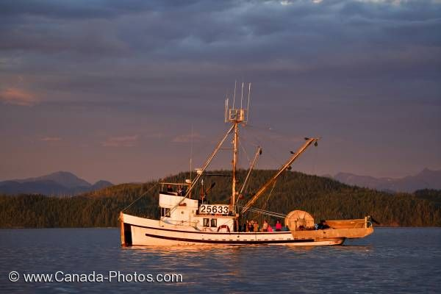
Collective Rights Charter Challenge: R. (The Queen) v. Sparrow

Slide 21
What Collective Rights are Present in the Charter?
Notes:
What Rights Should We Have?

