Slide 1
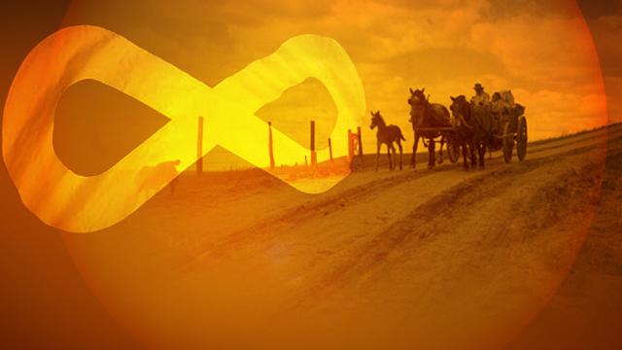
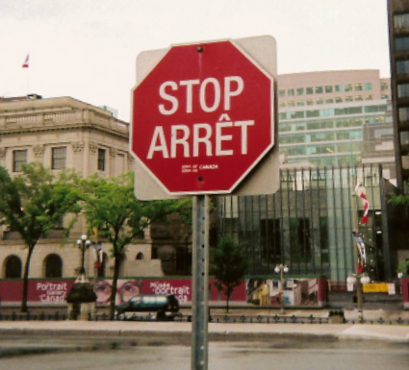
Collective Rights

Slide 2
Stoney Trail

Slide 3
To What Extent Should Canadians Support the Rights Present in the Canadian Charter of Rights and Freedoms?
Notes:
What Rights Should We Have?

Slide 4
Review
What are our individual rights?
Who is entitled to these rights?

Slide 5
“What are collective rights?”
Rights held by Canadians who belong to one of several groups in society.
They are recognized and protected by Canada’s constitution.

Slide 6
“Why do only some people have collective rights?”
Collective rights recognize the founding peoples of Canada.
Canada wouldn’t exist today without the contribution of these peoples.

Slide 7
What Collective Rights are Present in the Charter?
Notes:
How would you define Collective? Who gets these Rights, while other groups do not? What is the qualifiers?

Slide 8
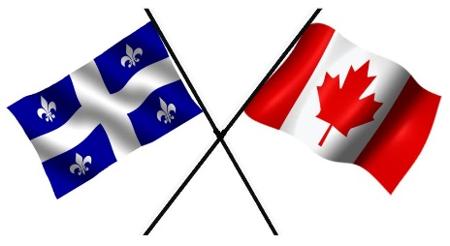
What Are Collective Rights?
Special rights held by Canadians who belong to certain groups:
English and French speakers
First Nations
Metis

Slide 9
What Are Collective Rights?
Inherent Rights:
Powers which people are justly entitled
Rights that existed before Canada

Slide 10
Inherent Rights
Notes:
How is the right to hunt inherent to First Nations?
What is an inherent right which you have?

Slide 11
What Are Collective Rights?
Meant to:
Protect unique cultures of Canada’s founding peoples
Restore equality for founding peoples
Notes:
Who might that equality have been taken away from?

Slide 12
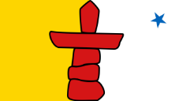
Canada’s Founding Peoples
First Nations
Metis
French
English
Canada could not exist without contributions of each
Notes:
If all of these people did not cooperate, Canada would probably not exist today – we would probably be American

Slide 13
What Are Each Group’s Collective Rights

Slide 14
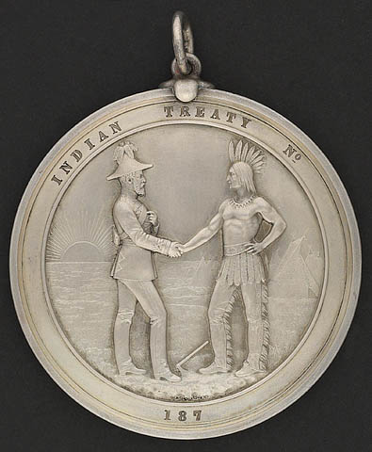
These medals were struck to commemorate the Numbered Treaties. This medal dates from 1874. The images are meant to convey a specific message. What was it? What clues are there in the images?

Slide 15
First Nations Rights
Anything mentioned in Treaty
Pg. 125:
Healthcare
Education
Hunting / Fishing Rights
Land reserves
Annuities
($5 / year)

Slide 16
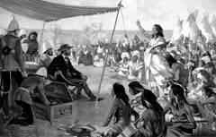
Eleven "Numbered Treaties" were signed between 1871 and 1921 as the Canadian government began to pursue settlement, farming and resource development in the west and north of the country.

Slide 17
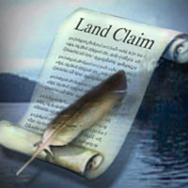
The terms of the treaties differed, but in most cases First Nations agreed to share their land and resources in exchange for education, hunting and fishing rights, reserves, farming assistance and annuities.

Slide 18
Numbered Treaties

Slide 19
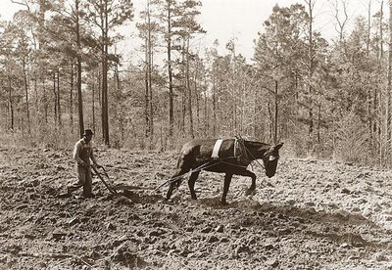
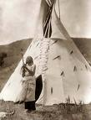
For example, Treaty 7 made provisions for one square mile of land for each Indian family, plus a limited supply of cattle, some farm equipment (one plow for each band) and a small amount of treaty and ammunition money.

Slide 20
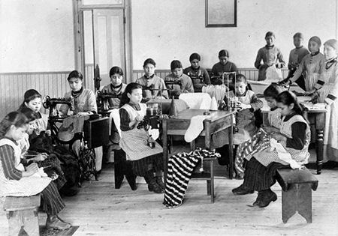
The treaty also made limited commitments on the part of the Queen to provide education for children and in some cases, medical services.

Slide 21
Both the Canadian government and the First Nations had their own reasons for signing the Numbered Treaties. Use the following pictures to determine what the reasons could have been.

Slide 22
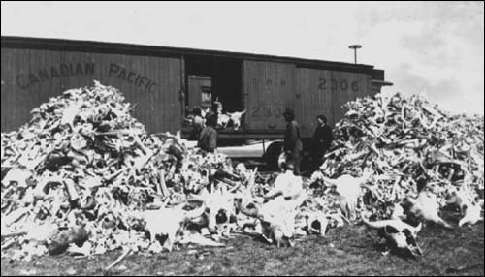
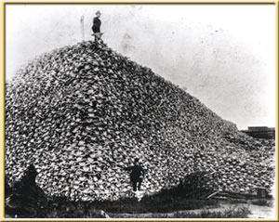
The eradication of the buffalo meant social and economic upheaval for some First Nations peoples. They saw the Treaties as a way to secure their future.

Slide 23
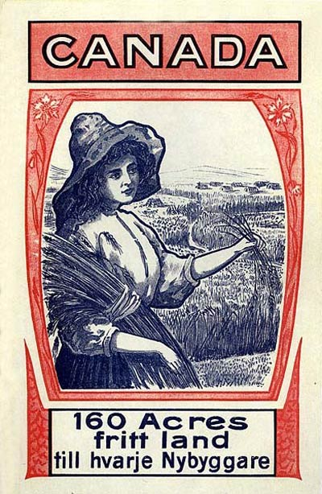
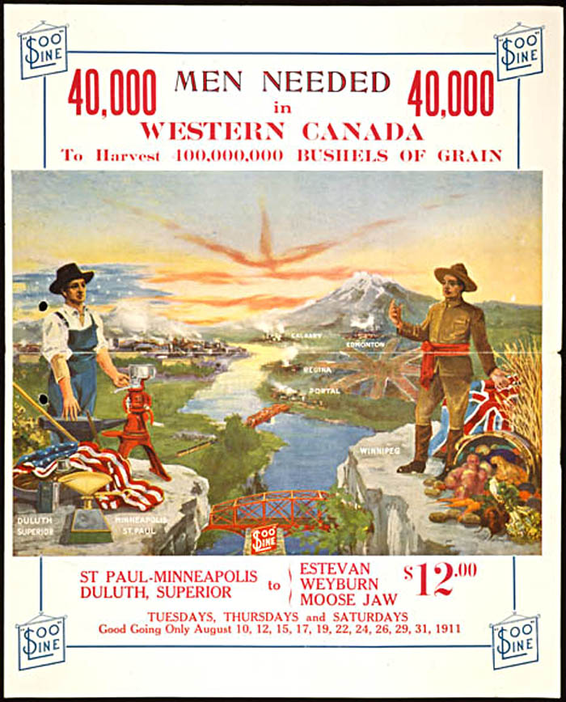

Slide 24
BC had joined Confederation on the condition that Canada would build a railway within ten years to link the province with the rest of Canada.
The railway also allowed a large number of immigrants to migrate to Canada’s West in hopes of a better life. They had been promised land by the government.
Both of these issues required that Canada obtain land from the First Nations.

Slide 25
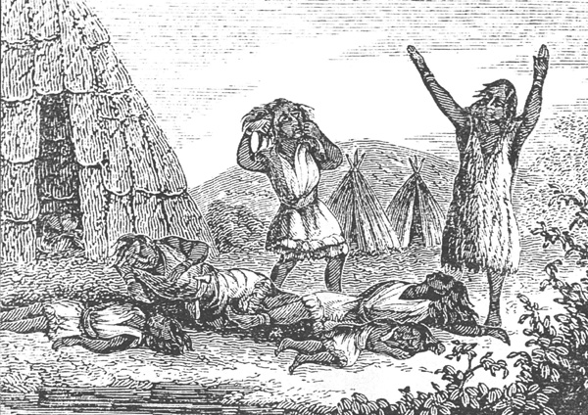
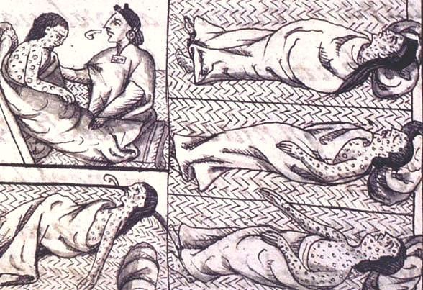
Small pox epidemics had taken a horrible toll on the First Nations both socially and economically.

Slide 26
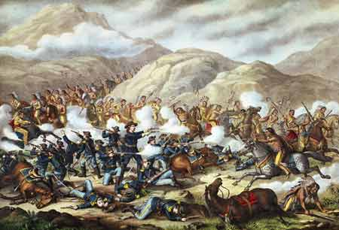
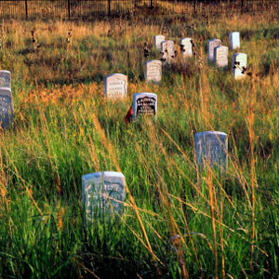
Both First Nations and Canada’s government wanted to avoid wars over territory like those happening in the United States. The treaties provided a peaceful way of meeting the needs of both groups.

Slide 27
Metis Rights
Right to be a First Nation
Hunting and Fishing Rights
Other rights under negotiation

Slide 28
The Metis: descendants of First Nations peoples and French settlers
The Metis are one of Canada’s Aboriginal peoples under Canada’s constitution
However, unlike the First Nations, the Metis do not have any historic treaties with Canada’s government
They believe they have inherent rights, which are rights they have strictly because they are First Peoples

Slide 29
Metis
Today, the Metis are represented in Canada by several organizations
Two are in Alberta: the Metis Nation of Alberta and the Metis Settlements General Council
The Metis speak French, therefore they are Francophones

Slide 30
What laws recognize the collective rights of the Metis?
Quick timeline:
1869-1870: Metis-led Red River Resistance resulted in the Manitoba Act, passed by Canada’s parliament, which made Manitoba a bilingual province and gave land rights to the Metis people
1875-1879: Canada’s government changed its mind and instead offered issued “scrip” to the Metis, which was a document that could be exhanged for land. In other words, instead of establishing Metis lands in Manitoba, they gave them a choice: accept scrip or become Treaty Indians under the Numbered Treaties (which do you think they would want?)

Slide 31
1885: the Northwest Resistance sought to protect Metis lands in what is today Saskatchewan where the railway was being laid and settlers were moving in
Two different interpretations of this event: the Metis view it as a way to assert their rights, the government saw it as a threat to their authority
1938: after being forced to move their settlements constantly over a long period, L’Association des Metis de l’Alberta et des Territoires du Nord-Ouest lobbied Alberta’s government to set aside land for the Metis

Slide 32
Alberta’s government then passed the Metis Population Betterment Act, which established twelve temporary Metis settlements
1940-1960: unfortunately, these settlements still did not give the Metis control of their land and were closed when the land became less useful for farming and hunting
1982: the Metis lobbied for recognition of Metis rights in Canada’s constitution and were successful

Slide 33
Finally, in 1990, Alberta’s government enacted legislation under which the Metis received the Metis settlements as a permanent land base with the right to manage their own affairs. The legislation included:
Constitution of Alberta Amendment Act
Metis Settlements Accord Implementation Act
Metis Settlements Act
Metis Settlements Land Protection Act
2003: Supreme Court ruled that the Metis have the right to hunt and fish as one of Canada’s Aboriginal peoples under the constitution

Slide 34
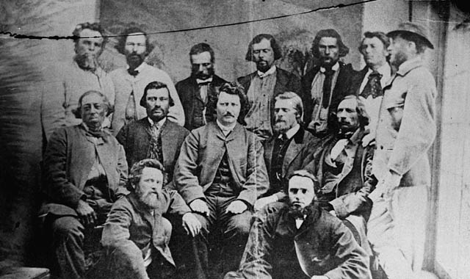
How do the Metis see their rights?
In 1996, the president of the Metis Nation of Alberta, Audrey Poitras said: “One of the fundamental aspects of Metis rights is our ability to define ourselves. It’s not up to the government, or non-Metis people, to define who is Metis. Only the Metis Nation itself can make those kinds of distinctions.”

Slide 35
Language Rights
Right to:
Communicate with the government in English or French
Be publically educated in English or French

Slide 36
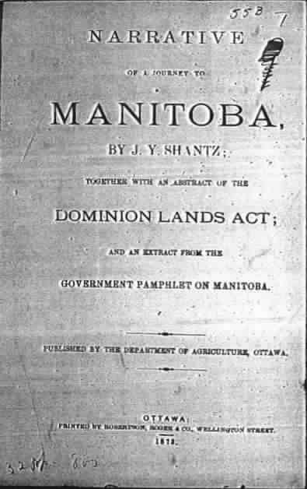
Challenges of Collective Rights
Notes:
What do you think a challenge of collective rights may be based on these three documents? Look at the dates, the formats, etc. – Very old – hard to interpret today

Slide 37
Challenges of Collective Rights

Slide 38
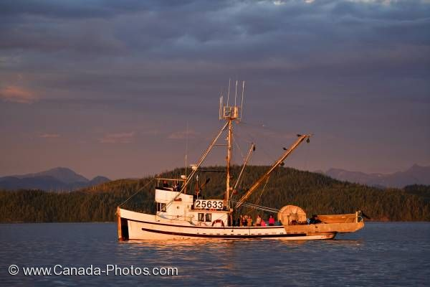
Collective Rights Charter Challenge: R. (The Queen) v. Sparrow

