Slide 1
Canadian Language Rights

Slide 2
Official language Community
An official language community are the groups in Canada that speak one of the official languages of Canada.
If you are part of an official language community you are either an:
Anglophone- A person whose first language is English
Francophone- Person whose first language is French

Slide 3
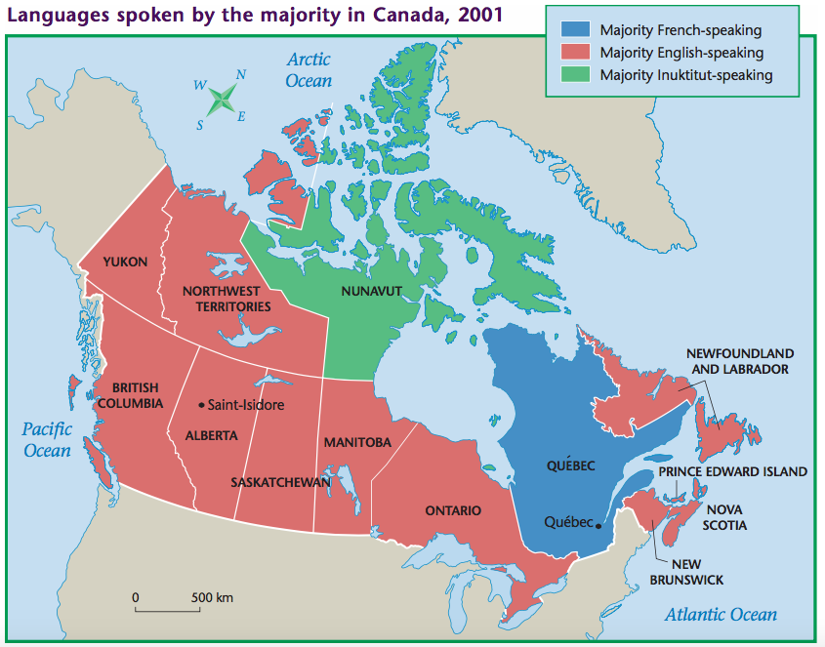
What can you infer from this map?

Slide 4
Official language minorities
If you are a group that speaks one of Canada’s official languages and that language does not make up the majority of the language spoken in your province or territory.

Slide 5
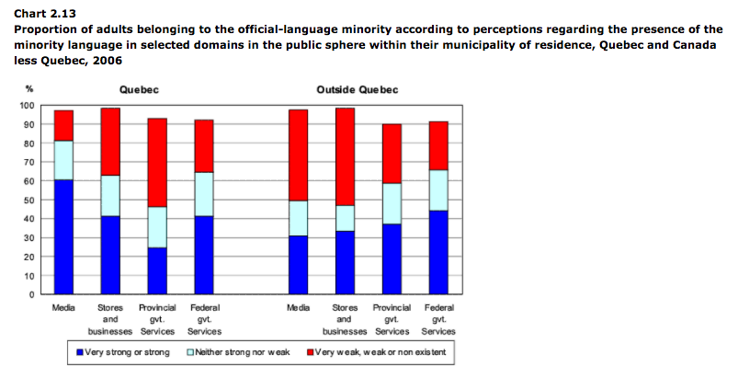
What inferences can you make from the chart?

Slide 6
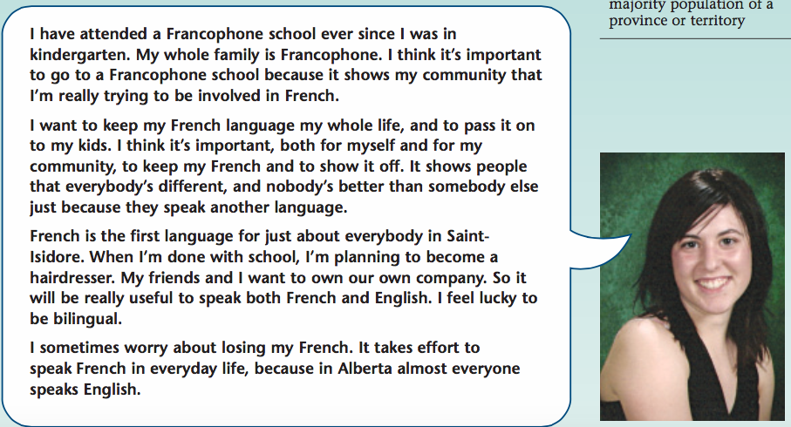
Where do you think this student lives?
Alberta

Slide 7
What language rights do you have in Canada?
Canada is bilingual. You can conduct your business with the federal government in either French or English.
New Brunswick is the only official bilingual province.
New Brunswick is the only official bilingual province- meaning you can conduct your business with the provincial government in both French and English. In Canada’s history there was one other bilingual province but only for a brief moment. Which province do you think it was?

Slide 8
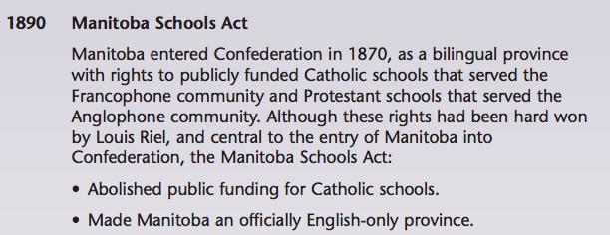

Slide 9
Section 23 of the Charter
What does this mean?

Slide 10
Language Education
You can be educated in English in Quebec (French speaking majority & English Speaking Minority)
You can be educated in French in an English speaking majority province.
If there are a X amount of people living in an English speaking province and Y amount of people want to be educated in French they can start a publicly funded Francophone school. Vise Versa for Quebec and English speakers
X = total provincial population Y = % of language minority living in the province

Slide 11
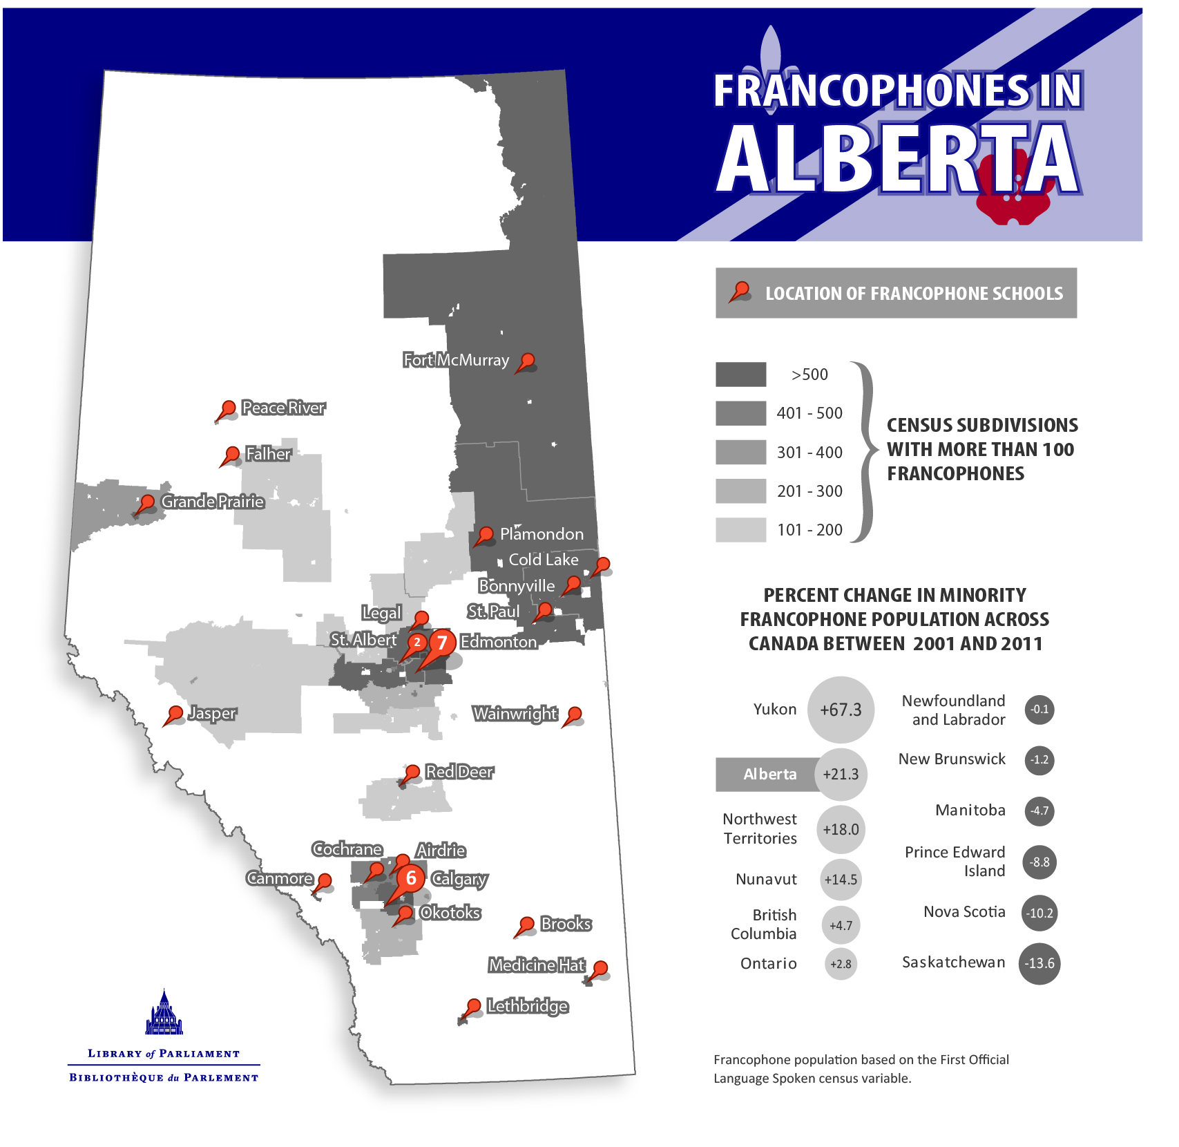

Slide 12
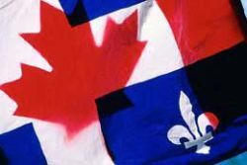
Quebec
English language in Quebec

Slide 13
Why Quebec wants language rights
Is this fair that Quebec gets to say this and not other language minorities? What do you remember about Canadian history?

Slide 14
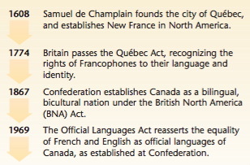
Britain just fought an imperial war with France (7 years war). One thing that came out of that war was Britain gained control of Canada (Upper/ Lower Canada at the time). To minimize the need for more military conflict Britain passed the Quebec Act

Slide 15
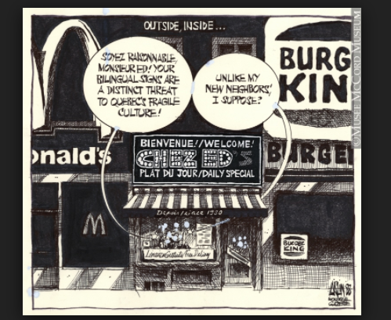
Quebec has always had to fight for French language rights.

Slide 16
But it goes both ways...

Slide 17
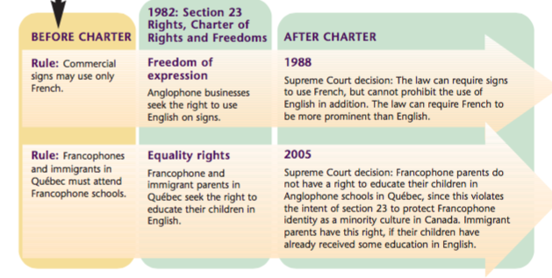
How do you think the Charter of Rights and Freedoms (1982) responded to Bill 101 (1977)

