Slide 1
How Bills Become Laws

Slide 2
Discussion Questions
Which branch of government has the power to create new bills/laws?
More specifically, what are the jobs within the sections of that branch of government?

Slide 3
Discussion Questions
The legislative branch of government can propose all the bills it wants to, but only some of them will survive the long and tedious journey to becoming a real law.

Slide 4
First Reading
BILL
Once a bill has been proposed, the first step is what is called a “First Reading.”
The bill is printed out and distributed to members of the House of Commons.
There is no debate, no vote, just a reading of the proposed bill (Hence why this is called the “First Reading.”)

Slide 5
Guess what comes next?

Slide 6
Second Reading
All involved have now had the chance to peruse the new bill.
It comes back to the House of Commons and there is a debate and a vote on the principle of the bill.
The PRINCIPLE of the bill: they are not voting to pass the bill, just deciding whether they are going to pay any attention to the bill or not.
Is this even worth our time?
MPs

Slide 7
Two options after the SECOND READING
Or…

Slide 8
Guess what comes next?

Slide 9
If the bill is approved to move on to…
The Committee Stage

Slide 10
The Committee Stage
This is a detailed study of the bill.
A committee of MPs or Senators study the bill further.
They investigate the bill with the help of witnesses, people directly impacted, FNMI elders, scientists, specialists… people who are experts in the field.
They would then issue a REPORT on the bill with any recommendations that they may have.
This may be where sneaky Lobbyists influence government.

Slide 11
Committee Stage
There are a few things that could happen with the committee stage:
The bill gets accepted.
The bill gets amended.
The bill gets rejected.
If the bill gets amended or accepted, it goes to the report stage.
If it is rejected, it is DEAD!

Slide 12
Report Stage
In this stage, there is another discussion, debate, and vote on the proposed bill/on the bill and its amendments.

Slide 13
Guess what comes next?

Slide 14
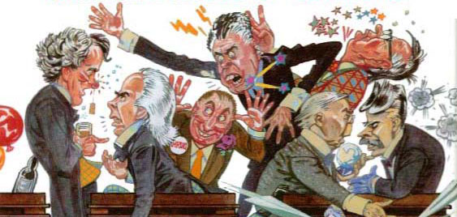
Third Reading
After the Report Stage, the bill moves forward to a Third Reading regardless of whether or not there were any amendments made.
Again, here the MPs or Senators discuss, debate, and then vote on the FINAL FORM of the bill.

Slide 15
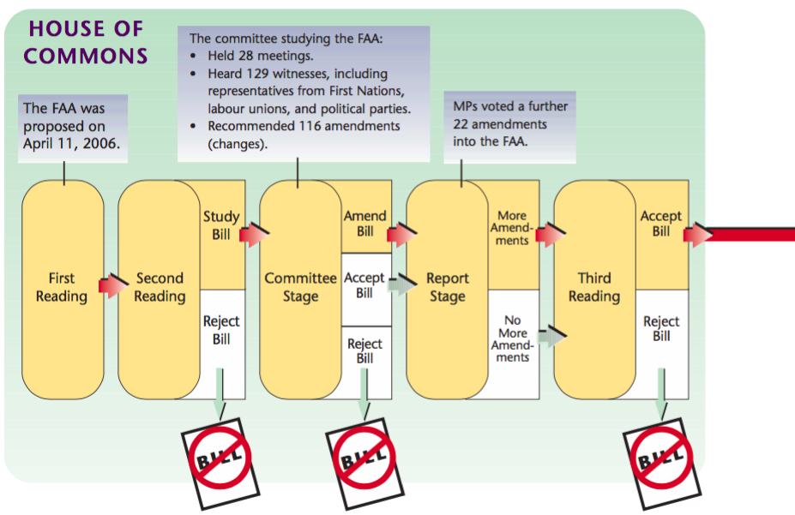

Slide 16
The Senate
After the House of Commons passes a bill the Senate goes through the exact same process.
Let’s do it all over again!

Slide 17
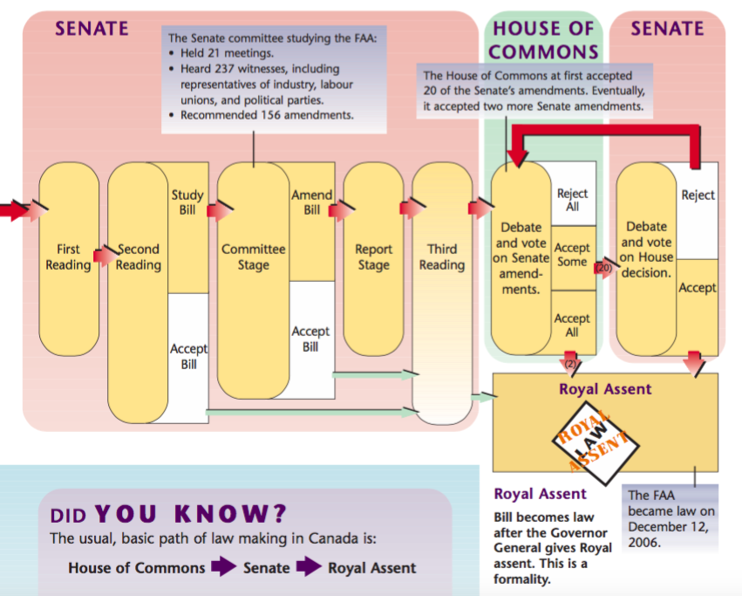

Slide 18
Trust the Process
First
Reading
Second
Reading
Study
Bill
Committee
stage
Amend
Bill
Report
stage
Third
Reading
Accept
Bill
Accept
Bill
The Senate usually accepts bills, although sometimes they do amend them. Bills are rarely rejected by the Senate.

Slide 19
Guess what comes next?

Slide 20
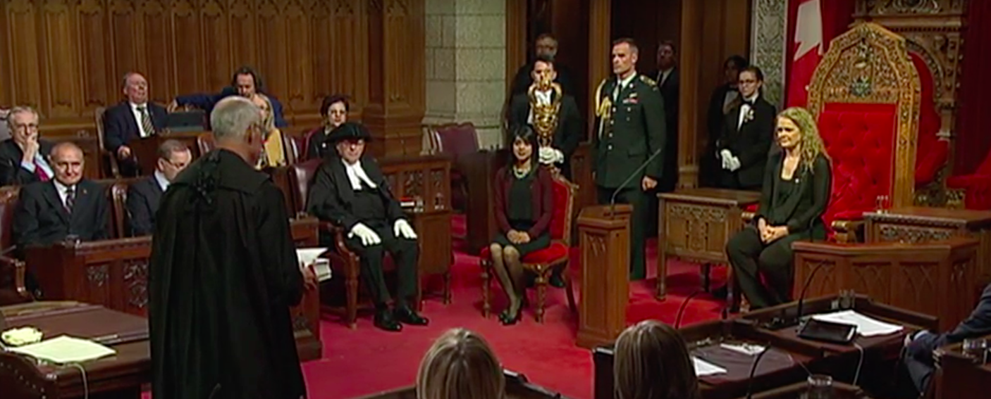
Lastly, the bill still needs to be approved by Canada’s monarchy. Typically, the Governor General is the power that give Royal Assent to a bill, which changes it into a law.

Slide 22
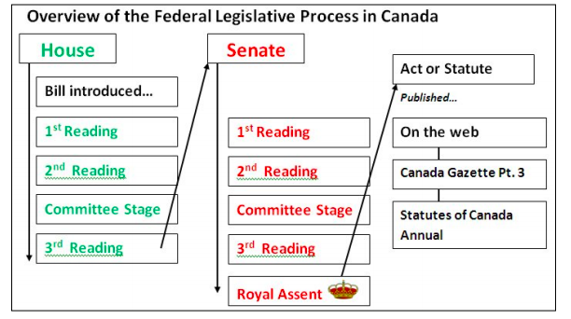

Slide 23
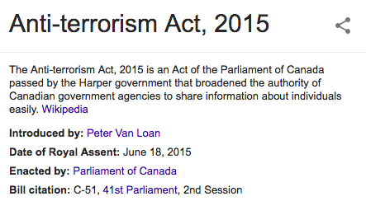

Slide 24
